Slide 1
Azure Confidential Computing powered by AMD SEV-SNP Workshop
V1.4 – July 2023 aka.ms/Azure-CC-AMD-Workshop

Slide 2
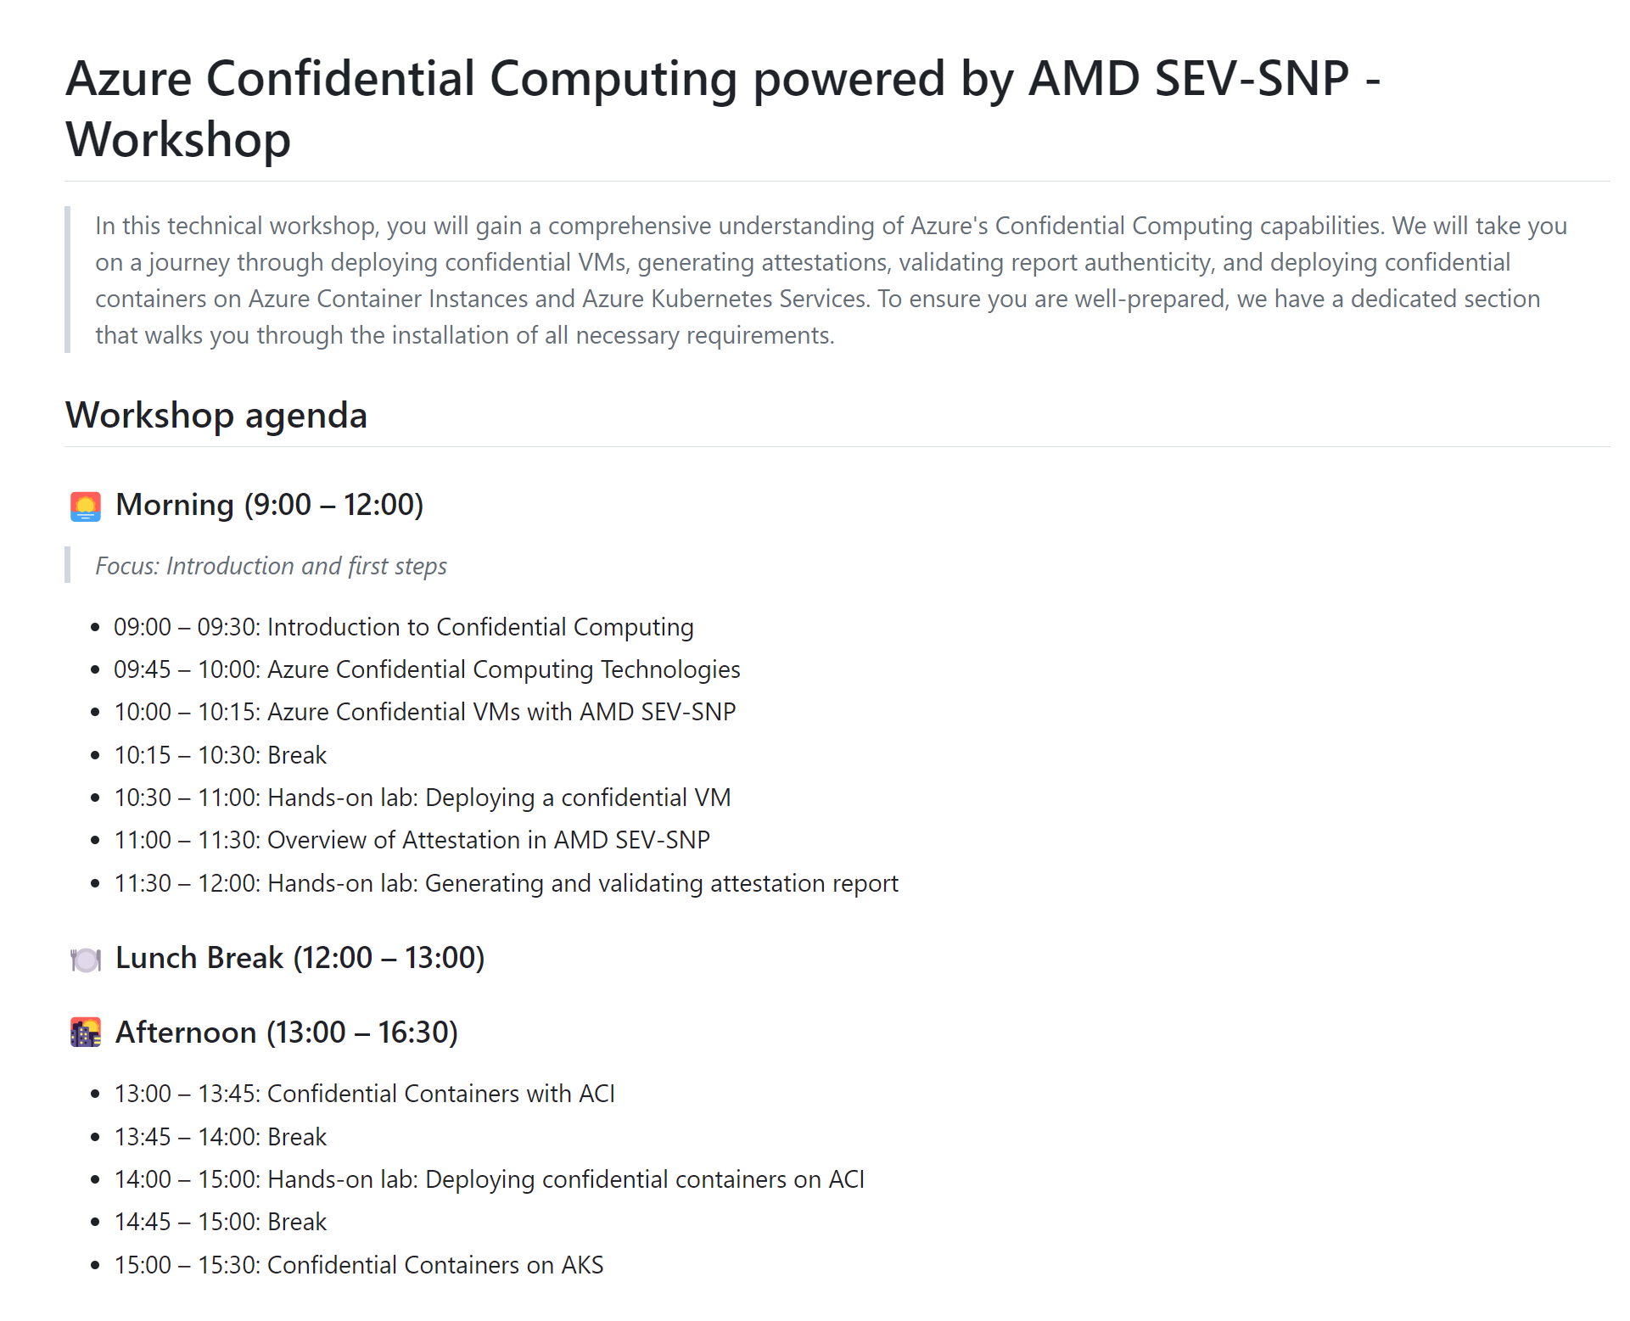
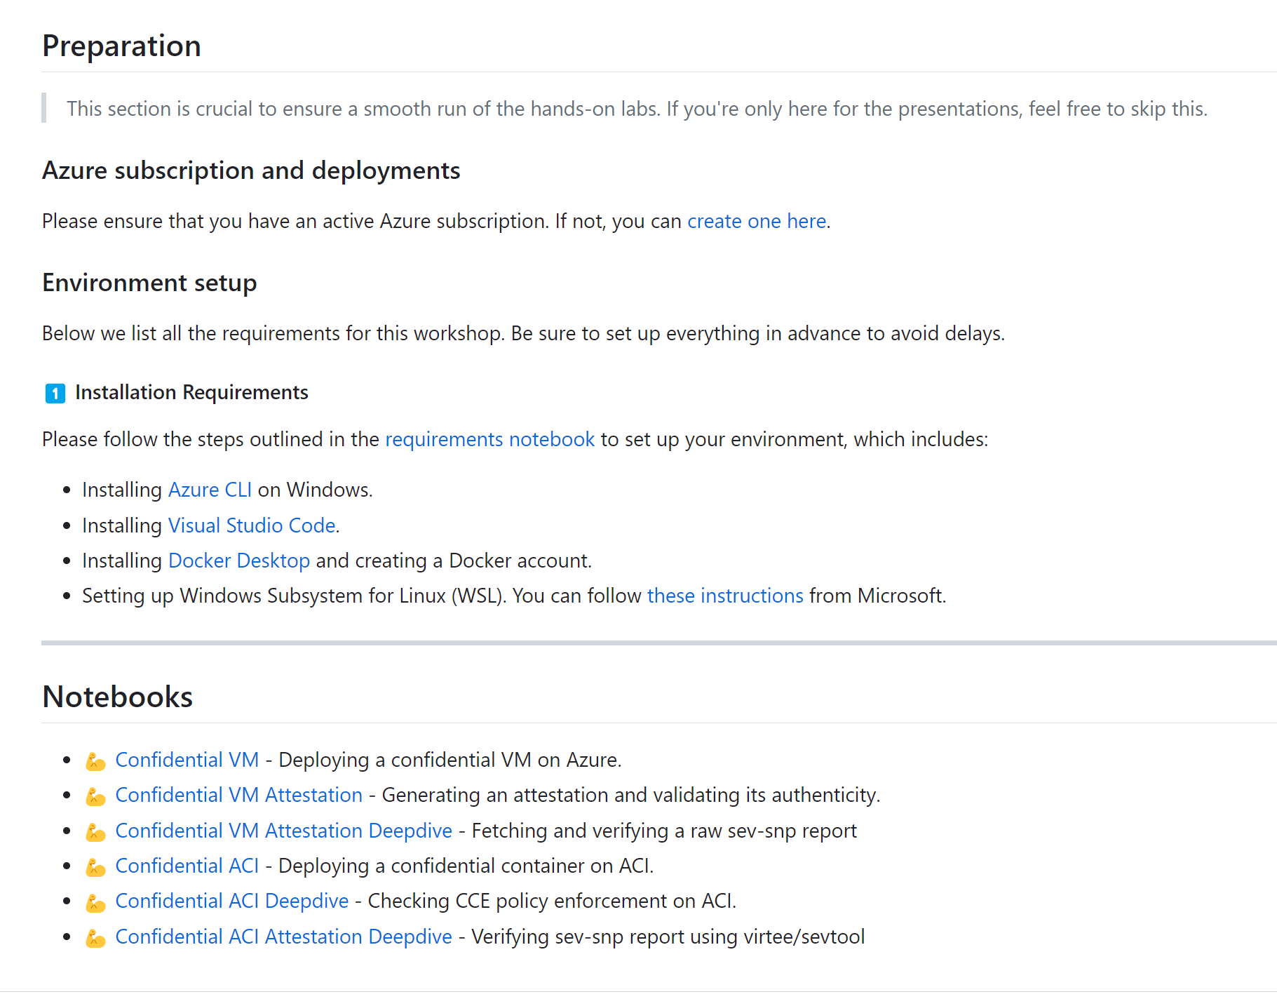
Workshop overview
aka.ms/Azure-CC-AMD-Workshop

Slide 3
Goal for today
Theory
Introduction to confidential computing
Azure Confidential Computing Technologies
Azure Confidential VM with AMD SEV-SNP
Overview of Attestation in AMD SEV-SNP
Confidential Containers with ACI (Azure Container Instances)
Confidential Containers on AKS (Azure Kubernetes Service)
Hands-on Lab
Deploying a confidential VM on Azure
Generating and validating attestation report
Deploying confidential containers on ACI enforced with a CCE policy

Slide 4
Plan for today
Time (CET) | Topic
09:00 – 09:30 | Introduction to Confidential Computing
09:45 – 10:00 | Azure Confidential Computing Technologies
10:00 – 10:15 | Azure Confidential VMs with AMD SEV-SNP
10:15 – 10:30 | Break
10:30 – 11:00 | Hands-on lab: Deploying a confidential VM
11:00 – 11:30 | Overview of Attestation in AMD SEV-SNP
11:30 – 12:00 | Hands-on lab: Generating and validating attestation report Part 1: Using Microsoft Azure Attestation Part 2: Using VirTEE SNP-Guest tool
12:00 – 13:00 | Lunch break
13:00 – 13:45 | Confidential Containers with ACI
13:45 – 14:00 | Break
14:00 – 15:00 | Hands-on lab: Deploying confidential containers on ACI Part 1: Generating a CCE policy Part 2: Validating attesting report using VirTEE SNP-Guest tool Part 3: Demonstrating the CCE policy
15:00 – 15:30 | Confidential Containers on AKS

Slide 5
Acronym
HCL: Host Compatibility Layer
OCI: Open Container Initiative
Open GCS: Open Guest Compute Service
PSP: Platform Security Processor
RoT: Root of Trust
SEV: Secure Encrypted Virtualization
SKR: Secure Key Release
SNP: Secure Nested Paging
SVSM: Secure Virtual Machine Module
TCB: Trusted Computing Base
TEE: Trusted Execution Environment
THIM: Trusted Hardware Identity Management
TPM: Trusted Platform Module
UVM: Utility VM
VCEK: Versioned Chip Endorsement Key
VMPL: Virtual Machine Privilege Levels

Slide 6
Introducing Confidential Computing

Slide 7
Customer motivations
Preventing unauthorized access
Full control over the data lifecycle
Untrusted collaboration
Regulations and compliance
Customers are increasingly looking for ways to trust as little as possible
Many workloads will not move to cloud due to lack of trust
Subpoena-proof services

Slide 8

Customer’s trust in the cloud
Operations
Regulations
Services (Control/Paas)
Data sharing
No externals
OS
Guest OS
Hypervisor/ Host
VM Admin
App
Data
Host
Customer
Physical access

Slide 9
Data protection
EXISTING ENCRYPTION
CONFIDENTIAL COMPUTING
Data at rest
Data in transit
In use
Encrypt inactive data when stored in blob storage, database, etc.
Encrypt data that is flowing between untrusted public or private networks
Protect/encrypt data that is in use, while in RAM and during computation

Slide 10









Confidential Computing Consortium
PREMIER
The Confidential Computing Consortium (CCC) brings together hardware vendors, cloud providers, and software developers to accelerate the adoption of Trusted Execution Environment (TEE) technologies and standards
A community focused on projects securing data in use and accelerating the adoption of confidential computing through open collaboration
Microsoft is a founding member, and chairs both the governing board and the Technical Advisory Council (TAC) of this open source community
GENERAL
@ConfidentialC2
*Other names and brands may be claimed as the property of others.

Slide 11
Azure confidential computing portfolio
Item | Description | Purpose
Virtual machines | Multiple options from AMD and Intel support confidential computing. | Create confidential computing from raw virtual machines.
Microsoft Azure Attestation | The remote attestation service in Azure | Use for validating the trustworthiness of multiple TEEs and verifying the integrity of the binaries running inside the TEEs.
Azure Key Vault Managed HSM | A cloud service that enables you to safeguard cryptographic keys for your cloud applications | Store and manage your private keys in a fully managed, highly available, single-tenant, standards-compliant service that uses FIPS 140-2 Level 3 validated hardware security modules (HSM).
Trusted Launch | A feature set in Generation 2 VMs that brings hardened security features to virtual machines in Azure | Protect against boot kits, rootkits, and kernel-level malware with a secure boot and virtual trusted platform module with boot integrity monitoring.
Confidential Containers on ACI | Use AMD SEV-SNP with ACI | Protect the confidentiality of the container's processes and data, in case someone gains unauthorized access to the underlying host operating system.
App-enclave aware containers | Use Intel SGX with Azure Kubernetes Service (AKS) | Create confidential computing nodes on AKS to isolate applications within an enclave environment.
Confidential VM node pools on AKS THIM | Container node pools that take advantage of VMs that use a hardware-based TEE The Trusted Hardware Identity Management service handles cache management of certificates for all trusted execution environments (TEEs) that reside in Azure. | Confidential VMs using AMD container applications deny the hypervisor and other host-management code access to VM memory and state and add defense in depth protections against operator access. It provides trusted computing base (TCB) information to enforce a minimum baseline for attestation solutions.
Notes:
What is Azure confidential computing? - Training | Microsoft Learn

Slide 12
Azure Confidential Computing Technologies

Slide 13
Azure confidential computing
Existing encryption
Confidential computing
Data at rest
Encrypt inactive data when stored in blob storage, database, etc.
Data in transit
Encrypt data that is flowing between untrusted public or private networks
Data in use
Protect/encrypt data that is in use, while in RAM, and during computation
Protect Against
Insider Threat
Privileged admins abusing rights
Cloud Components
Removing need to trust Hypervisor/OS
Third Parties
Accessing data without customer consent
In Azure, confidential computing means…
A hardware root-of-trust, customer verifiable remote attestation, and memory encryption

Slide 14
Azure Confidential Computing
NEW!
Save Money
Bring more workloads to the Cloud, even with sensitive data
In Use
Unlock Value
Enable insights without ceding access or control over data
Protect data throughout the entire data lifecycle
Be Compliant
Meet increasingly stringent privacy and security regulatory requirements
Trust and Verify
Stay in control of data access by verifying data is protected
In Transit
At Rest

Slide 15

What is Confidential Computing?
The protection of data in use by performing computation in a hardware-based, attested Trusted Execution Environment (TEE) which provides data integrity, data confidentiality, and code integrity.
App
VM
Container
…
TEE
Host OS
Code
Hypervisor
Data
Hardware
Notes:
Reference: OC3 Conference - Removing Host and HV from TCB
https://www.youtube.com/watch?v=Htt5vy4H2Iw

Slide 16

What is Confidential Computing?
The protection of data in use by performing computation in a hardware-based, attested Trusted Execution Environment (TEE) which provides data integrity, data confidentiality, and code integrity.
App
VM
Container
…
TEE
At Microsoft, we evolved our virtualization stack so that a Confidential VM can be:
Azure Host OS
Code
executed inside a TEE, whereby code and data within the entire VM is protected from the hypervisor and the host OS, as well as from other confidential VMs and any hosting environment in the TEE.
Hyper-V Hypervisor
Data
Hardware
Notes:
Reference: OC3 Conference - Removing Host and HV from TCB
https://www.youtube.com/watch?v=Htt5vy4H2Iw

Slide 17

Azure confidential computing and AMD SEV-SNP
AVAILABLE TODAY
OS
Confidential Containers on ACI Confidential Pods (Containers) on AKS (Preview)
Technology: Attestation, Secure Key Release, Cloud sealing
Guest OS
Hypervisor/ Host
Services (Control/Paas)
Containers
“I just trust my app code and the chip.”
VM Admin
Host
Physical access
AVAILABLE TODAY
Confidential VMs with AMD SEV-SNP Confidential VM node pool support on AKS Technology: (Trusted VM), Secure Key Release, Blind Hypervisor
OS
Guest OS
Hypervisor/ Host
Services (Control/Paas)
Confidential VMs
“Microsoft cannot touch my stuff in my VM.”
VM Admin
Host
Physical access
AVAILABLE TODAY
Trusted Launch VMs as default
Technology: VM Attestation, VM Secure Boot, vTPM, Virtualization-Based Security
OS
Guest OS
Hypervisor/ Host
Services (Control/Paas)
Trusted VMs
“Only known, trusted code is running on my VM.”
VM Admin
Host
Physical access
TRUST
Notes:
Reference: Announcing Trusted Launch as default in Azure Portal - Microsoft Community Hub

Slide 18
Azure Confidential VMs with AMD SEV-SNP

Slide 19
Confidential Virtual Machine with AMD SEV-SNP
Generally available
General Purpose
Virtual Machine
Confidential
Virtual Machine
AMD SEV-SNP
Application
Application
CVM is isolated by CPU hardware from Hypervisor and Smart NIC
1
Attest
Benefits
A VM that is Confidential
Isolation from Azure as the CSP
No code changes required
Independent hardware Root Of Trust (RoT)
Customer verifiable attestation
Confidential key management
Achieve near general purpose performance
2
Execute
Optional
Encrypted memory
Encrypted memory
(Confidentiality & Integrity)
Hypervisor
Smart NIC
BIOS, SMM, Device Drivers, …
Embedded FW
CPU Hardware

Slide 20


Azure Confidential VMs Powered by AMD SEV-SNP
3rd Generation AMD EPYCTM 7763v (Milan) processors with SEV-SNP technology
Make your applications confidential without any code changes.
Availability: GA
DCasv5 and ECasv5 VM Series
VM memory encrypted, and integrity protected by CPU-created keys
Full OS disk encryption with keys sealed in vTPM
Guest attestation capability rooted to AMD’s RoT
Notes:
Reference: OC3 Conference - Customer managed TCB with CVMs on Azure
https://www.youtube.com/watch?v=1gRaL8BCKhE

Slide 21



Azure Confidential VMs Powered by AMD SEV-SNP
OS Support and Region Availability
VM Sizes
Operating Systems
Regions
General Compute
DCasv5, DCadsv5
United States
Ubuntu Server 22.04
Ubuntu Server 20.04
West US, East US
Memory Optimized
ECasv5, ECadsv5
Europe
Windows Server 2022
Windows Server 2019
Windows 11 22H2
SQL server on WS2022/2019
North Europe, West Europe
Now in Preview
Coming this Summer 2023
Southeast Asia, Japan, Italy, Switzerland
Red Hat Enterprise Linux 9.2
Notes:
Reference: Microsoft Build 2023
AMD + Azure: Outstanding performance and the latest security features | Microsoft Build 2023 - YouTube

Slide 22
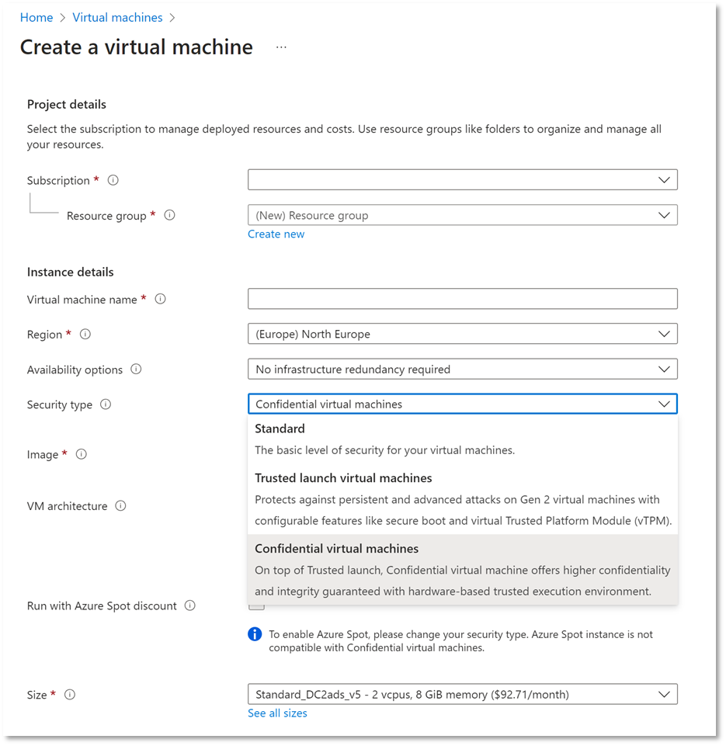
How to create a Confidential Virtual Machine
To create a Confidential Virtual Machine, login to and navigate to “Virtual Machines” under Azure services. On the Create a virtual machine page, select Confidential virtual machines.
It’s that easy!

Slide 23
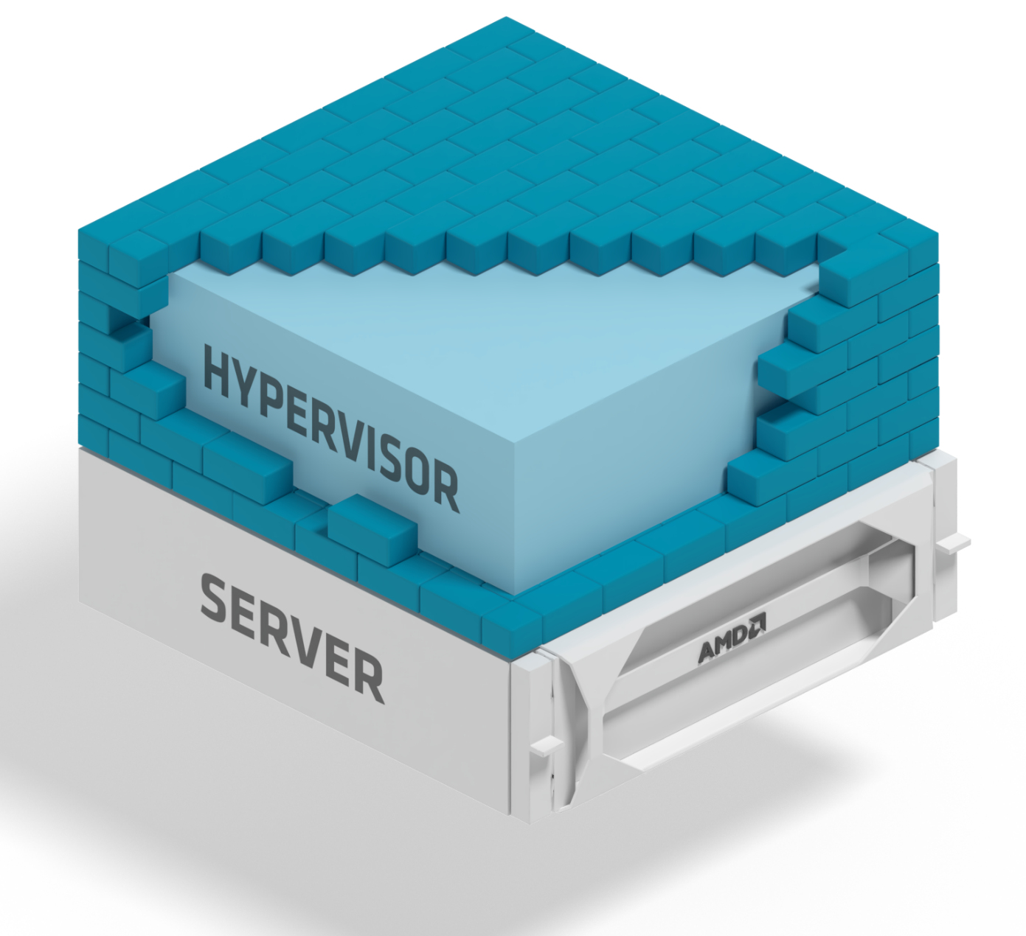
The foundation of Confidential VM’s - AMD Infinity Guard
SEV
Secure Encrypted Virtualization
Encrypt Each VM with Unique Keys
SEV-ES
Encrypted State
VM Integrity with Protected CPU Registers
Secure Nested Paging
Hardware Protection Against Malicious Hypervisors
Leveraged by Azure confidential computing products
SEV-SNP
For more info, go to: https://developer.amd.com/sev
Notes:
Reference: Microsoft Build 2023
AMD + Azure: Outstanding performance and the latest security features | Microsoft Build 2023 - YouTube

Slide 24
History of AMD SEV-SNP
Secure Nested Paging (SEV-SNP) is the latest generation of AMD Secure Encrypted Virtualization (SEV) technology designed for Confidential Computing
SEV-SNP builds on existing AMD SEV and AMD SEV-ES (Encrypted State) features to provide stronger security, additional use models, and more to protected VMs
SEV and SEV-ES supported in 1st and 2nd Generation AMD EPYCTM Processors (2017)
SEV-SNP supported starting in 3rd Generation AMD EPYCTM Processors (2021)
SEV-SNP is designed to protect a VM from a malicious hypervisor in specific ways
Useful in public cloud and any scenario where the hosting environment cannot be trusted
SEV
Memory confidentiality
SEV-ES
Register confidentiality
SEV-SNP
Integrity protection and more
Notes:
Reference: AMD SEV-SNP Development Update - David Kaplan, Advanced Micro Devices & Brijesh Singh, SMTS - YouTube

Slide 25
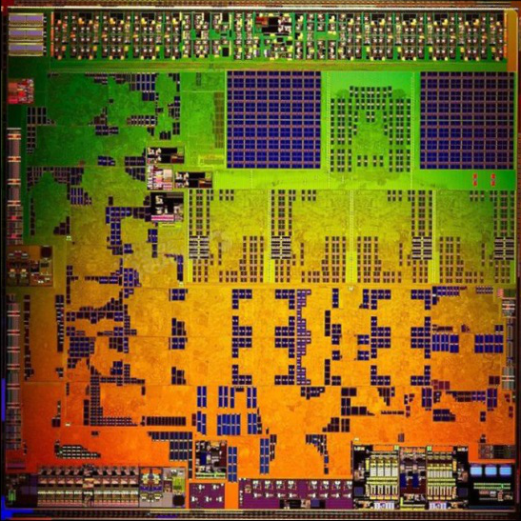
AMD - A Dedicated Security Subsystem
AMD SOC
AMD Secure Processor integrated within SoC
32-bit microcontroller
Runs an OS/kernel with improved security
Off-chip NV storage to help protect firmware and data (i.e., SPI ROM)
Provides cryptographic functionality for key generation and key management
Enables hardware validated boot
Hardware Root of Trust Provides Foundation for Platform Security
AMD SECURE PROCESSOR
ROOT OF TRUST
Notes:
Reference: Microsoft Build 2023
AMD + Azure: Outstanding performance and the latest security features | Microsoft Build 2023 - YouTube

Slide 26
AMD – Platform Security Processor
The Platform Security Processor (PSP) firmware implements the security environment for hardware-isolated VMs, providing a unique identity to the CPU by deriving the Versioned Chip Endorsement Key (VCEK) from chip-unique secrets and the current TCB version.
The PSP also provides ABI functions for managing the platform, the life-cycle of a guest VM, and data structures utilized by the PSP to maintain integrity of memory pages.
AMD Secure Memory Encryption (SME) is a general-purpose mechanism for main memory encryption that is flexible and integrated into the CPU architecture, provided via dedicated hardware in the on-die memory controllers that provides an Advanced Encryption Standard (AES) engine.
This encrypts data when it is written to DRAM, and then decrypts it when read, providing protection against physical attacks on the memory bus and/or modules.
The key used by the AES engine is randomly generated on each system reset and is not visible to any process running on the CPU cores; instead, it is managed entirely by the PSP.
Each VM has memory encrypted with its own unique key, which is stored in a secure location within the PSP firmware and never exposed outside of it.
AMD SECURE PROCESSOR
ROOT OF TRUST

Slide 27

EPYC™ Hardware based Memory Encryption
AMD Secure Processor
AMD EPYC x86 CPU
AES-128 engine in the memory controller
Encryption keys managed by AMD Secure Processor / not exposed to x86 CPU
Guest OS chooses pages to encrypt via page tables
No changes to end user applications needed
AMD Secure Memory Encryption (SME)
All system memory is encrypted using randomly generated key on each system reset
Transparent SME is OS agnostic and not visible to OS
AMD Secure Encrypted Virtualization (SEV)
Provides strong cryptographic isolation between the VMs, as well as between the VMs and the hypervisor
Active encryption key selected by virtual machine ID
Memory Controller
Memory
AMD EPYC | UNIQUE MEMORY KEYS
7001 | 16
7002 | 509
7003 | 509
AMD Infinity Guard features vary by EPYC™ Processor generations. Infinity Guard security features must be enabled by server OEMs and/or Cloud Service Providers to operate. Check with your OEM or provider to confirm support of these features. Learn more about Infinity Guard at https://www.amd.com/en/technologies/infinity-guard . GD-183
Notes:
Reference: Microsoft Build 2023
AMD + Azure: Outstanding performance and the latest security features | Microsoft Build 2023 - YouTube

Slide 28
Enterprise Workloads on Azure Confidential Computing VMs
Take-aways:
Minimal performance impact running on Azure Confidential Computing VMs vs. standard general purpose VMs
No need to recompile applications which saves time and money
Confidential virtual machines offer the same specs as general purpose Dasv5/Dadsv5 and Easv5/Eadsv5
1.
The Data
Protection and Performance you want
2.
3.
*MLNC-016 through 21. See Endnotes
Notes:
Reference: Microsoft Build 2023
AMD + Azure: Outstanding performance and the latest security features | Microsoft Build 2023 - YouTube

Slide 29

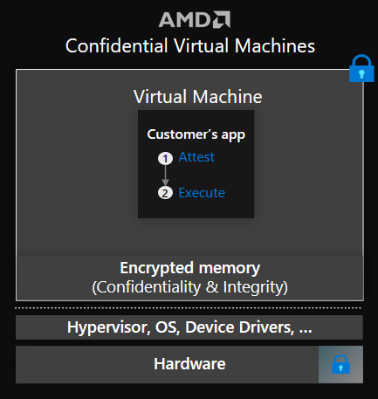
General Available
Azure Confidential VMs Powered by AMD SEV-SNP
Azure confidential VMs harden guest protection without app code changes.
Hardware-based VM memory encryption with integrity protection, and keys are generated and safeguarded by AMD processors.
OS full disk encryption can be turned on with customer own keys, which is cryptographically bonded with customized release policies, and keys can reside in Azure Key Vault or Azure Managed HSM.
Verifiable attestation reports reflect status of the AMD root-of-trust information, VM guest firmware measurements, VM configuration such as serial console, secure boot state, virtual TPM identity, and more.
Dedicated virtual TPM to seal secrets/keys. Secure boot capability protects entire boot path.
Notes:
Reference: Microsoft Build 2023
AMD + Azure: Outstanding performance and the latest security features | Microsoft Build 2023 - YouTube

Slide 30





Confidential VMs – Hardware based isolation
Provisioning and deployment flows.
Confidential VM
Data Disk
Temp Disk
Application
5
Application can optionally perform TPM attestation to onboard additional secrets to CVM.
5
OS Disk
OS
4
TPM unseal and OS boot
3
Load guest bootmanager
UEFI
VTL0
VTL2
2
Request attestation token and VMGS key
VMGS Disk
Host Compatibility Layer
vTPM
MAA | KMS
Contains firmware state
UEFI
vTPM
1
Load Guest firmware and initialize.
Hypervisor
CPU BIOS, Device Drivers, …
Hardware
CVM Deployment
HW RoT anchors trust back to HW manufacturer

Slide 31
Confidential VMs – Hardware based isolation
Provisioning and deployment flows.
Confidential VM
Data Disk
Cloud Provisioning Service
Generates firmware state including vTPM.
Encrypts firmware state with key bound to KMS
Customer managed key or
System managed key
Optionally encrypts OS disk with key sealed into the vTPM.
Orchestrates key rotation workflows for CVMs.
Temp Disk
Application
5
Application can optionally perform TPM attestation to onboard additional secrets to CVM.
OS Disk
OS
4
TPM unseal and OS boot
3
Load guest bootmanager
UEFI
VTL0
VTL2
2
Request attestation token and VMGS key
VMGS Disk
Host Compatibility Layer
vTPM
MAA | KMS
Contains firmware state
UEFI
vTPM
1
Load Guest firmware and initialize.
Hypervisor
CPU BIOS, Device Drivers, …
Hardware
HW RoT anchors trust back to HW manufacturer

Slide 32
Remote attestation and Secure Key Management
TEE Host
Key + Policy
Hardware Root of Trust
Hardware Security Module (HSM)
Attestation Service Microsoft Azure Attestation (MAA)
Key Management System (KMS) Azure Key Vault AKV Managed HSM
TEE
VMGS Disk
Attestation Token
Secure Key
2
4
Attestation Report
Attestation Token
1
3
Verify identity and integrity → release keys and secrets

Slide 33
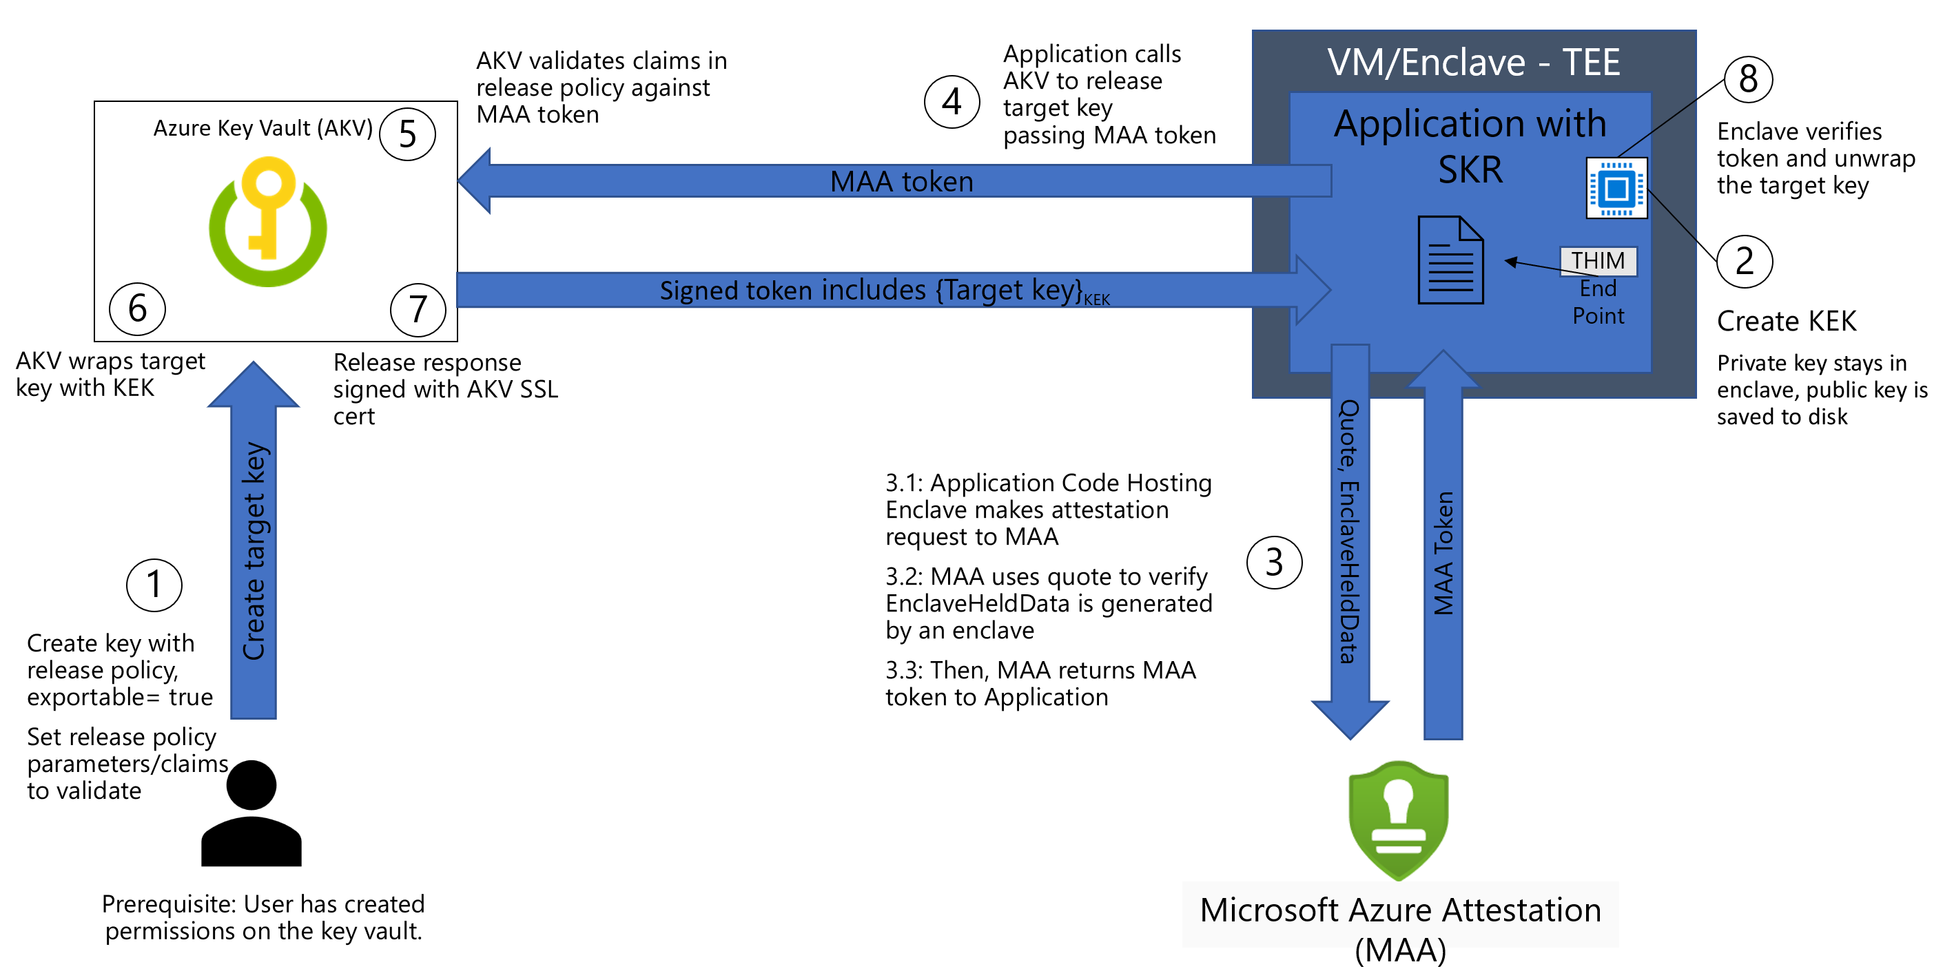
Overall Secure Key Release Flow with TEE
https://learn.microsoft.com/en-us/azure/confidential-computing/concept-skr-attestation

Slide 34
Architecture of Confidential VMs on Azure

Slide 35
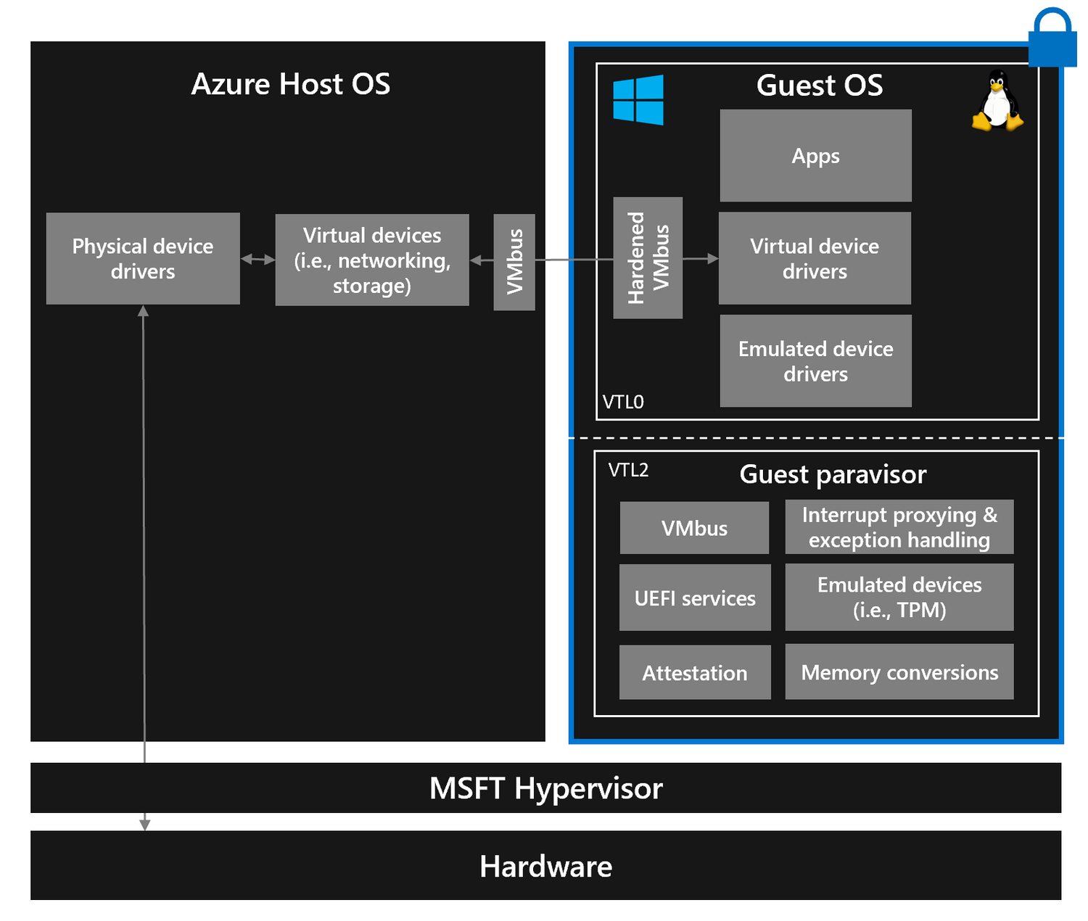
How did we do it?
TCB = Trusted Computing Base
In our mission to build the Azure Confidential Cloud and enable customers to lift and shift their sensitive workloads, we evolved our virtualization stack (i.e., paravisor) to enable both Windows and Linux operating systems to easily run inside Confidential VMs across hardware architectures.
I/O Devices
CPU
Memory
Notes:
Reference: OC3 Conference - Removing Host and HV from TCB https://www.youtube.com/watch?v=Htt5vy4H2Iw

Slide 36




Guest paravisor
TCB = trusted computing base
The guest paravisor implements the TEE enlightenments on behalf of the guest OS so the guest OS can run mostly unmodified.
Azure Host OS
Guest OS
App 1
App 2
App N
VTL0
VTL2
Guest paravisor
Hyper-V hypervisor
I/O Devices
CPU
Memory
Notes:
Reference: OC3 Conference - Removing Host and HV from TCB https://www.youtube.com/watch?v=Htt5vy4H2Iw

Slide 37
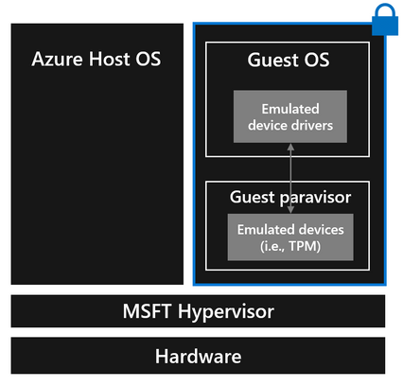

Emulated Devices
We moved emulated devices (like TPM, RTC, serial, etc.) from the Host OS to the guest paravisor which gave us the ability to provide Confidential VMs a TPM and Secure Boot.
The guest paravisor is running in the guest but isolated from the guest OS
CPU state
10101
10101
11101
CPU
Notes:
Reference: OC3 Conference - Removing Host and HV from TCB https://www.youtube.com/watch?v=Htt5vy4H2Iw Confidential VMs on Azure - Microsoft Community Hub

Slide 38
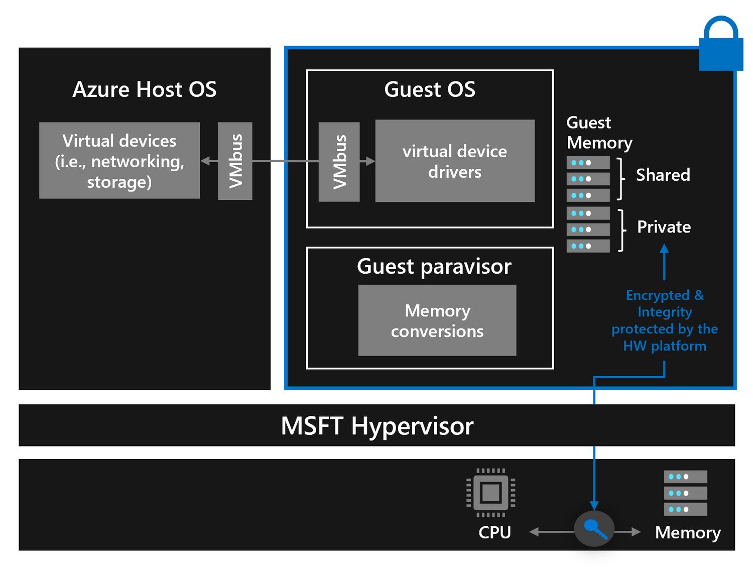
Memory Protections
Two types of memory:
Private Memory: Default computation memory for Confidential VMs.
Shared Memory: Used for communication with the virtualization stack, e.g., device IO.
Page Visibility:
Memory can be either private or shared, referred to as its page visibility.
The guest can convert memory between private and shared as needed.
Private pages are used by default.
To use a shared page, the guest must manage page visibility.
Confidential VMs need to protect secret data in shared memory.
Notes:
Reference: OC3 Conference - Removing Host and HV from TCB https://www.youtube.com/watch?v=Htt5vy4H2Iw Memory Management Components:
Components such as virtual device drivers enable the use of our mechanism to manage page visibility.
The mechanism allows the guest to maintain a pool of shared memory.
Data is sent to the host by allocating a bounce buffer from the shared memory pool.
Dynamic Memory Conversion Model:
The pool of shared memory is not fixed and can adapt to the needs of the workload.
The confidential computing platform prevents the hypervisor or anything other than the code inside the Confidential VM from making pages shared.

Slide 39
An example
Azure Host OS
Guest OS
App
GPA | GPA
N | Buffer
… | buffer
3 | data
2 | data
1
0
Virtual devices
(i.e., networking, storage)
virtual device drivers
data
Shared
VMBus
VMBus
Hardware key
data’
SSL
Private
Physical device drivers
data
Guest Paravisor
Memory conversions
Hyper-V hypervisor
I/O Devices
CPU
Memory
data’
Internet
End-to-end protection
Notes:
Reference: OC3 Conference - Removing Host and HV from TCB https://www.youtube.com/watch?v=Htt5vy4H2Iw

Slide 40
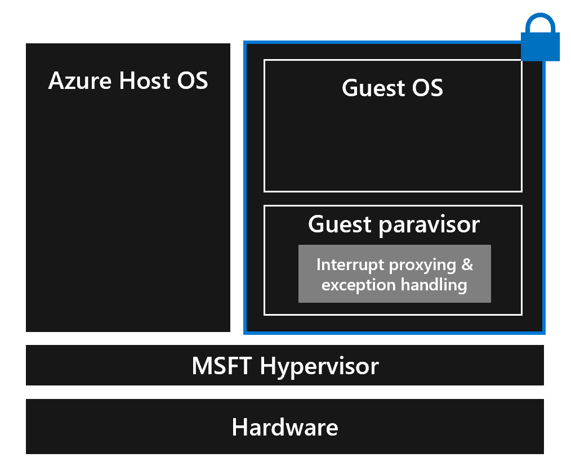
Execution State Integrity
The guest paravisor can do interrupt proxying, validating interrupts coming from the hypervisor and handle the new special CVM exception type on behalf of the guest OS.
Guest Paravisor Role:
A crucial component within a Confidential VM, the guest paravisor, acts as an intermediary, ensuring secure interrupt handling.
Interrupt Proxying: The paravisor validates interrupts coming from the hypervisor, thereby shielding the guest OS.
Re-injection of Valid Interrupts: After validation, the paravisor re-injects the interrupt into the guest OS.
New Exception Type with Confidential VMs:
This is a hardware-specific exception that is generated solely by the hardware.
Instead of the virtualization stack, the guest VM is responsible for handling this new exception type.
The paravisor can handle this exception on behalf of the guest OS, providing an extra layer of security.
Notes:
Reference: OC3 Conference - Removing Host and HV from TCB https://www.youtube.com/watch?v=Htt5vy4H2Iw
Interrupt Controller Emulation:
Our hypervisor typically emulates the APIC to generate emulated interrupts for guests.

Slide 41
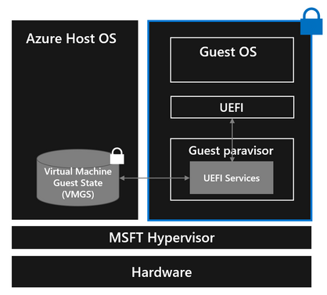
Guest firmware protection
Guest firmware can store and access guest state and guest secrets that are inaccessible to the Host OS.
UEFI Firmware Evolution: The guest UEFI firmware has been updated to retrieve trusted UEFI attributes from a new Virtual Machine Guest State (VMGS) file, packaged as a VHD, instead of from the host.
Secure Storage: The VMGS.VHD file is encrypted, providing Confidential VM's firmware access to persistent storage that remains inaccessible to the host. The host interacts only with the encrypted VHD.
Authenticated UEFI Variables: Managed by the guest paravisor, authenticated UEFI variables offer enhanced security from both the host and guest OS.
Variable Writing Process: When a Confidential VM employs UEFI runtime services to write a variable, the guest paravisor processes and persists the authenticated variable rights in the VMGS file.
Persistent Storage & Access: The updated design allows a Confidential VM to use the VMGS file for persistent storage and access to VM guest state and secrets, such as UEFI state and TPM state if desired by the customer.
Notes:
Reference: OC3 Conference - Removing Host and HV from TCB https://www.youtube.com/watch?v=Htt5vy4H2Iw

Slide 42
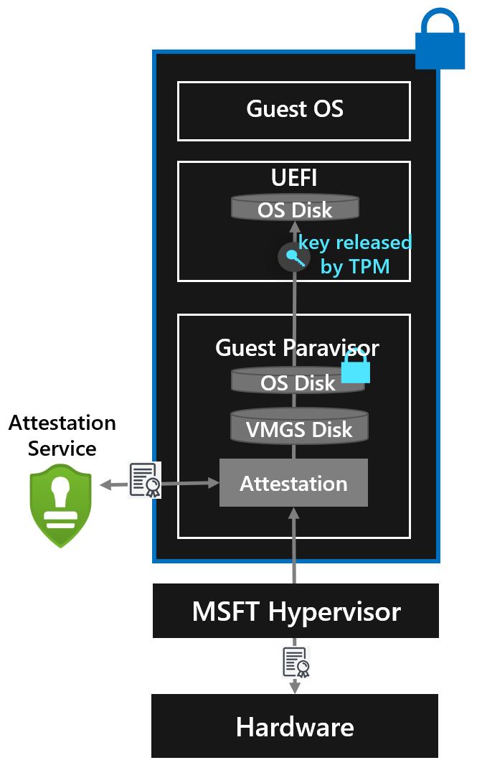
Remote Attestation
Attestation for a Confidential VM “conceptually authenticates the VM and/or the virtual firmware used to launch the VM”.
Initialization of a Confidential VM:
A partition for the Confidential VM on Azure is created and started.
The hardware seals the partition to prevent modification by the host.
Hardware platform provides a measurement of the guest's launch context.
Guest Paravisor Boot and Attestation:
The guest paravisor boots first, performing attestation for the guest OS.
A signed attestation report is requested from the hardware platform and sent to an attestation verification service. Any failures in attestation verification prevent the VM from booting.
Control Transfer and Secure Boot:
The guest paravisor transfers control to UEFI.
Secure Boot verifies the startup components, checking their signatures before loading.
Role of TPM Measured Boot:
UEFI accumulates measurements of startup components into the TPM's PCRs as they load.
For encrypted OS disks, the TPM only releases the decryption key if the VM’s firmware code, original boot sequence, and boot components remain unaltered.
Notes:
Reference: Confidential VMs on Azure - Microsoft Community Hub

Slide 43
Hands-on lab: Deploying Confidential VM

Slide 44
Hands-on lab will cover - cvm_deployment.md
Deploying a confidential VM on Azure
Building the sample application by using https://github.com/Azure/confidential-computing-cvm-guest-attestation
Requesting attestation from the VM by using the sample application
Displaying the JWT token generated by Microsoft Azure Attestation
Notes:
Hands-on lab: Deploying Confidential VM - cvm_deployment.md

Slide 45
Overview of Attestation in AMD SEV-SNP

Slide 46






Overview of Remote Attestation
3
Measurements sent to guest owner
Attestation Report
Security Processor
Guest Owner
Expected Measurements
Attestation
Policy
Measurements
Measurements
2
Measurements collected
Platform
Guest
Secrets and Trust
Accept
Reject
4
Guest owner decides to trust guest or not
5
Guest owner trusts guest with secrets
Launches guest
1
Hypervisor
Attestation delays and delegates the security decision of whether a guest is trustworthy to the guest owner.
Notes:
Reference: AMD SEV-SNP Attestation: Establishing Trust in Guests - Jeremy Powell, Advanced Micro Devices - YouTube

Slide 47
Overview of Attestation in AMD SEV-SNP
3
Measurements sent to guest owner
Attestation Report
AMD
Security Processor
Guest Owner
Expected Measurements
Attestation
Policy
Measurements
Measurements
2
Measurements collected
AMD
Firmware and ucode
SEV-SNP
Guest
Secrets and Trust
Accept
Reject
4
Guest owner decides to trust guest or not
5
Guest owner trusts guest with secrets
Launches guest
1
Hypervisor

Slide 48
Measurements of Trusted Computing Base (TCB)
AMD firmware and microcode
Security processor boot loader
Security processor operating system
SEV-SNP firmware
x86 Microcode
SEV-SNP Guest
Launch metadata and measurements
Guest configuration
x86 runtime configuration
AMD Hardware and Firmware
External PCI Devices (e.g., NIC, HDD)
CPU BIOS
Device Drivers
Hypervisor
Cloud Management Software
= Trusted
= Untrusted
SEV-SNP VM
Legacy
(unencrypted)
VMs
Legacy
(unencrypted)
VMs
Legacy
(unencrypted)
VMs
Legacy
(unencrypted)
VMs
Legacy (unencrypted) VMs
Other SEV-SNP
VMs
Notes:
Reference: AMD SEV-SNP Attestation: Establishing Trust in Guests - Jeremy Powell, Advanced Micro Devices - YouTube

Slide 49
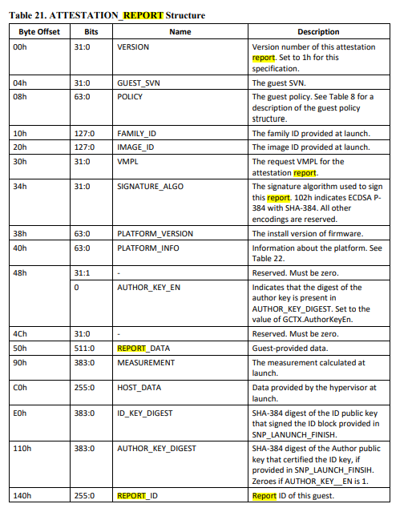
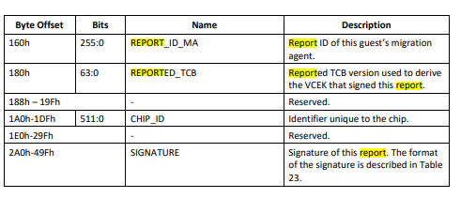
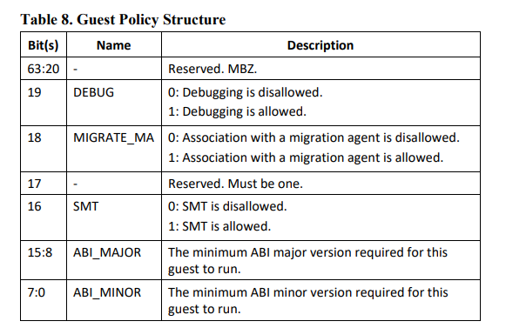
Overview of an AMD SEV-SNP attestation report
For more info, go to: https://developer.amd.com/sev

Slide 50
Content of an AMD SEV-SNP attestation report
Field | Description
Version | The version number of the report. At time of writing, this value will always be the hexadecimal value of 2.
Guest SVN | The Security Version Number (SVN) of the SNP Firmware.
Policy | The Guest Policy. This includes the minimum required ABI major and minor versions, whether or not SMT is allowed, if a migration agent is allowed, if debugging is allowed, and if it may be activated on single or multiple sockets.
Family ID | The family ID provided at VM launch as part of the Identity Block.
Image ID | The image ID provided at VM launch as part of the Identity Block.
VMPL | The requested VM Permission Level (VMPL) for the attestation report.
Signature Algorithm | The algorithm used to sign the generated report. At time of writing, this is ECDSA P-384 with SHA-384.
Current TCB | Security Version Numbers (SVNs) of the currently executing platform firmware and microcode.
Platform Info | Information about the system, namely if TSME or SMT is enabled on the system.
Signing Key | Encodes the key used to sign this report; either VCEK or VLEK.
Mask Chip Key | Reports if the MaskChipKey is set. Defaults to 0 (disabled), but when set to 1 (enabled), it prevents the attestation report from being signed and prevents the guest from using the VCEK in guest key derivations.
Author Key En | Indicates if the author key is present in AUTHOR_KEY_DIGEST.
Report Data | The 512-bit value provided by the guest as part of the guest request.
Measurement | The launch measurement calculated by the AMD Secure Processor.
Host Data | Unique data provided by the hypervisor (host) at launch.
ID Key Digest | SHA-384 digest of the ID public key that signed the ID block provided in SNP_LAUNCH_FINISH
Author Key Digest | SHA-384 digest of the Author public key that certified the ID key, if provided in SNP_LAUNCH_FINISH. All zeroes if AUTHOR_KEY_EN is 1.
Field | Description
Report ID | The unique report ID of this guest.
Report ID MA | The unique report ID of the guest’s migration agent.
Reported TCB | Reported TCB version used to derive the VCEK that signed this report.
Chip ID | If MaskChipId is set to 0, the unique ID of the chip, otherwise 0.
Committed TCB | SVNs of the anti-rollback minimum of the platform firmware and microcode.
Current Build | The build number of the current TCB Version.
Current Minor | The minor version number of the current TCB Version.
Current Major | The major version number of the current TCB Version.
Committed Build | The build number of the committed TCB Version.
Committed Minor | The minor version of the committed TCB Version.
Committed Major | The major version ofthe committed TCB Version.
Launch TCB | SVNs of the version of the platform firmware and microcode at time of launch of this guest.
Signature | The signature from the AMD Secure Processor including all of the aforementioned fields.
For more info, go to: https://developer.amd.com/sev

Slide 51
Attestation Report: Platform Measurements
Report Field | Description | Usage and Verification
CHIP_ID | Unique chip identifier | Connects the report to the certificate of the attestation key that signed this report
PLATFORM_INFO | Indicates properties of the platform configuration, such as whether whole system memory encryption or Simultaneous Multithreading (SMT) is enabled | Do you require whole system memory encryption to be on? Do you require SMT to be off?
CURRENT_TCB | Security Version Numbers (SVNs) of the currently executing platform firmware and microcode | Informational
COMMITTED_TCB | SVNs of the anti-rollback minimum of the platform firmware and microcode | Does this TCB address all the vulnerabilities you care about?
REPORTED_TCB | Hypervisor has option to report a lower version to ease continuity on TCB update | Connects the report to the certificate of the attestation key that signed this report
LAUNCH_TCB | SVNs of the version of the platform firmware and microcode at time of launch of this guest | Do you care if the guest once executed with a particular TCB version?
For more info, go to: https://developer.amd.com/sev
Notes:
Reference: AMD SEV-SNP Attestation: Establishing Trust in Guests - Jeremy Powell, Advanced Micro Devices - YouTube

Slide 52
Attestation Report: Guest Measurements
Report Field | Description | Usage and Verification
FAMILY_ID IMAGE_ID GUEST_SVN | Guest image identification information | Is this the image you expected?
MEASUREMENT | Measurement of the guest’s address space, including page types as defined in SNP_LAUNCH_UPDATE | Did the hypervisor set the guest up as you expected?
ID_KEY_DIGEST AUTHOR_KEY_DIGEST | Owner’s ID and Author key digests, identifying the owner | Is this you?
POLICY | SEV-SNP guest policy restricting various things like SEV-SNP debug commands | Is the policy what you expected?
REPORT_ID MA_REPORT_ID | Connects this attestation report to its migration agent’s report, if one is present. | Did you expect a migration agent to be bound to this guest? Does the migration agent’s attestation report check out?
For more info, go to: https://developer.amd.com/sev
Notes:
Reference: AMD SEV-SNP Attestation: Establishing Trust in Guests - Jeremy Powell, Advanced Micro Devices - YouTube

Slide 53
Guest Policy Definitions
Bit(s) | Name | Description
63:21 | - | Reserved. MBZ.
20 | SINGLE_SOCKET | 0: Guest can be activated on multiple sockets. 1: Guest can be activated only on one socket.
19 | DEBUG | 0: Debugging is disallowed. 1: Debugging is allowed.
18 | MIGRATE_MA | 0: Association with a migration agent is disallowed. 1: Association with a migration agent is allowed.
17 | - | Reserved. Must be one.
16 | SMT | 0: SMT is disallowed. 1: SMT is allowed.
15:8 | ABI_MAJOR | The minimum ABI major version required for this guest to run.
7:0 | ABI_MINOR | The minimum ABI minor version required for this guest to run.
The guest owner provides the guest policy to the firmware during launch. The firmware then binds the policy to the guest.
The guest policy is enforced by the firmware and restricts what configuration and operational commands can be performed on the VM by the hypervisor.
The policy also indicates the minimum firmware version to for the guest.
The guest policy provided when starting the VM is bound to that VM and cannot be changed throughout its lifetime.

Slide 54
Attestation Report: Guest Measurements
SNP_LAUNCH_START
Provided by Guest Owner
ID Block
SNP_LAUNCH_UPDATE
Launch Digest
Equal?
Launch Digest
Guest Policy
Met?
Image Metadata
SNP_LAUNCH_FINISH
Valid?
ID Key Signature
ID
Public Key
Certifies
Author Public Key
(Optional)

Slide 55
Identity block
As part of the input to the SNP_LAUNCH_FINISH command, the hypervisor may provide an optional data structure called the identity block.
Identity block contains the expected launch digest, guest policy, the guest identification and a guest owner signature.
The identity block's keys are stored in the guest context.
Attestation reports contain the identity block's public keys.
This enables the guest owner and the firmware to verify the launching process of the guest.
Provided by Guest Owner
ID Block
Launch Digest
Guest Policy
Image Metadata
ID Key Signature
Notes:
As part of the input to the SNP_LAUNCH_FINISH command, the hypervisor may provide an optional data structure called the identity block. The identity block contains the expected launch digest of the guest, information uniquely identifying the guest, the guest policy bitfield, and a signature by the guest owner. The provided launch digest is checked against the computed launch digest, and the provided policy is checked against the policy used to launch the guest. The identifying information is stored in the guest context to be used during key derivation and attestation. Finally, the firmware will check that the signature is valid.
The firmware stores the keys used to sign the identity block in the guest context. Attestation reports for the guest contain the public keys to reflect the binding of the guest to the guest owner. A guest owner that sees its public keys in the attestation report knows that the launch process used an identity block provided by that guest owner to validate the guest.

Slide 56

Authenticity of Attestation Report
Attestation report contains
identity information about the guest (from the launch sequence),
migration and policy information.
a block of arbitrary data supplied by the guest VM
Generated by AMD Milan Platform Security Processor
Signed by AMD-SP firmware using VCEK (Versioned Chip Endorsement Key) private key
Enable a thirty party to conduct remote attestation by validating a SNP report
ARK
ASK
Root of trust chained back to AMD Root
SNP Report
Report_data
Report_data = hash(report attached data)
VCEK
signature
Report attached data
SNP Report
Security Version
Policy
Report_data
SnpMeasurement
tcbver
hwid
For more info, go to: https://developer.amd.com/sev
signature
Notes:
The platform security processor (PSP) provides a unique identity to the chip by deriving the Versioned Chip Endorsement Key (VCEK) from chip-unique secrets and the reported TCB version. The PSP provides support for remote attestation, including issuing evidence (or attestation report) which can be used by a relying party to verify that the guest VM (i.e., the utility VM) has been created and configured as expected on a trusted AMD SEV-SNP CPU. The report is requested by a guest VM and issued and signed by the PSP using VCEK. VCEK is endorsed via a certificate that is rooted to AMD’s CA for Milan CPUs. The certificate chain is illustrated below.

Slide 57
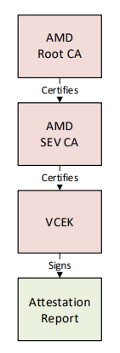
Authenticity of Attestation Report
Chip- Unique Secret
Certificates retrieved from AMD Key Distribution Service (KDS)
 |  | Bootloader SVN
 |  | OS SVN
 |  | SNP FW SVN
 |  | Microcode Patch Level
KDF
VCEK
REPORTED_TCB is mixed into the chip unique secret to derive the Versioned Chip- Endorsement Key (VCEK), which is used as the attestation key
AMD Certificate Authority certifies the VCEK
VCEK signs the attestation report
Notes:
Reference: AMD SEV-SNP Attestation: Establishing Trust in Guests - Jeremy Powell, Advanced Micro Devices - YouTube

Slide 58
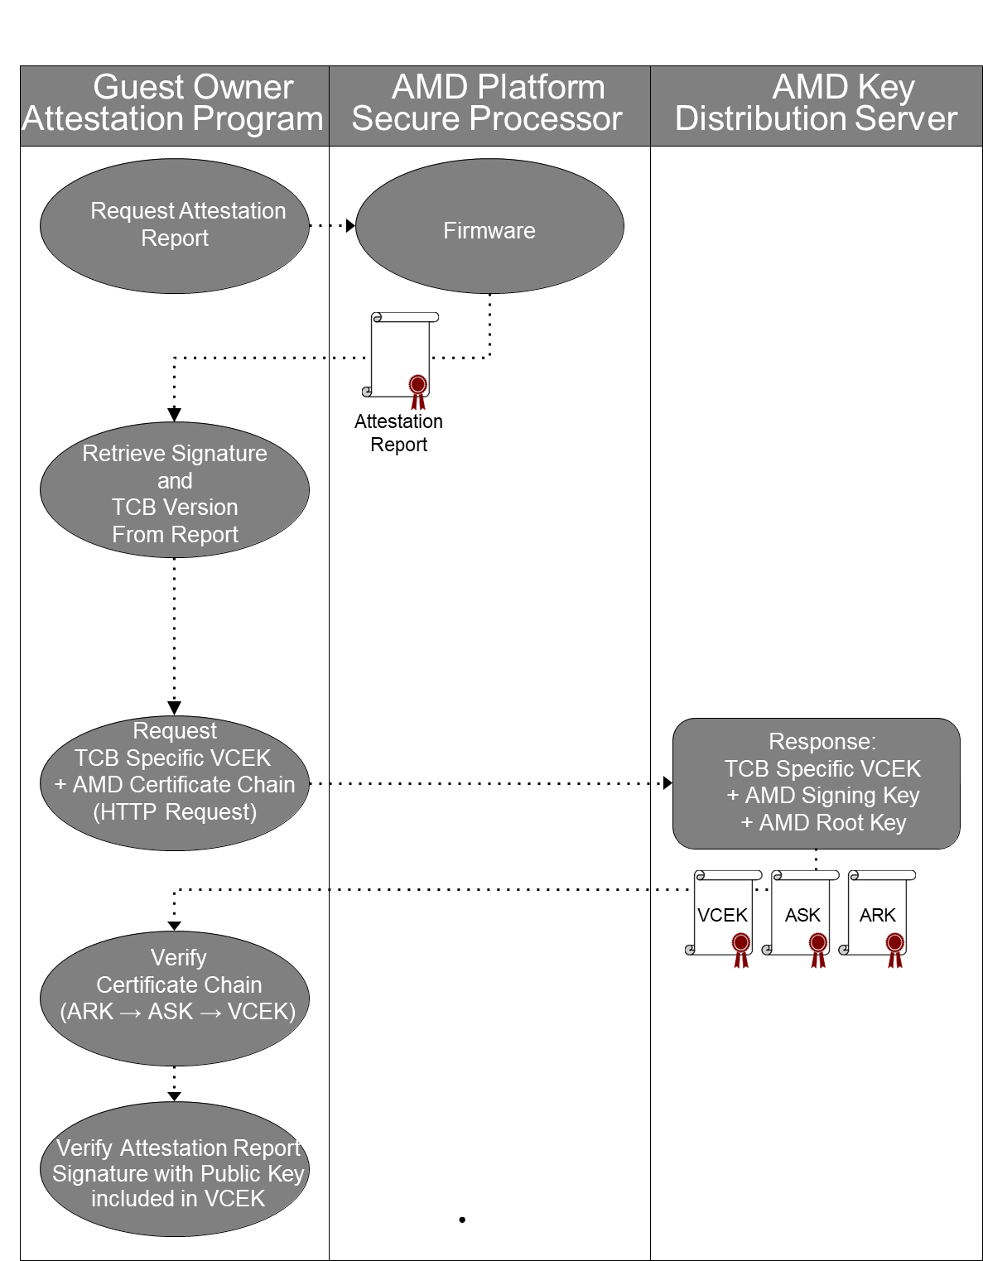
Regular Attestation Workflow
A valid signed attestation report guarantees:
The contents of report have not been modified or tampered with.
The report was generated by a specific, genuine, AMD EPYC Processor; which is correctly configured for SEV-SNP.
Virtual machine’s memory is in a safe state.

Slide 59
Retrieving Attestation Reports
Guest
Reports retrieved via guest message
Guest construct MSG_REPORT_REQ message
Guest encrypts and integrity protects message with key shared at guest launch
Guest sends wrapped request to hypervisor
Hypervisor invokes SNP_GUEST_REQUEST on wrapped request
SEV-SNP firmware returns attestation report through same channel
Linux guest retrieves reports via IOCTLs on /dev/sev-guest
SNP_GET_REPORT – retrieves report
SNP_GET_EXT_REPORT – retrieves report and certificates (see below)
Linux host can provide attestation key certificates via IOCTLs on /dev/sev
SNP_SET_EXT_CONFIG – stores attestation key certificates for retrieval by
/dev/sev-guest
/dev/sev-guest SNP_GET_REPORT
Hypervisor
SNP_GUEST_REQUEST
SEV-SNP
Firmware
E.g., VCEK certificate chain is retrieved from AMD Key Distribution Service (KDS) and stored in the host via SNP_SET_EXT_CONFIG. The guest retrieves the report and certificate chain via SNP_GET_EXT_REPORT.
For more info, go to: https://developer.amd.com/sev
Notes:
Reference: AMD SEV-SNP Attestation: Establishing Trust in Guests - Jeremy Powell, Advanced Micro Devices - YouTube

Slide 60
Binding Guest Credentials to Attestation Report
REPORT_DATA provided by guest
64 btyte field
Not interpreted by firmware
Placed into the attestation report
Guest can…
Generate a key pair
Calculate digest of public key
Place digest in REPORT_DATA
Send report and public key to relying party to use
Key could establish trusted channel
Key could chain trust to a virtual TPM
in guest
AMD
Root CA
Certifies
AMD SEV CA
Attestation Report
REPORT_DATA
VCEK Signature
Guest Keypair
Certifies
VCEK
Signs
Notes:
Reference: AMD SEV-SNP Attestation: Establishing Trust in Guests - Jeremy Powell, Advanced Micro Devices - YouTube

Slide 61
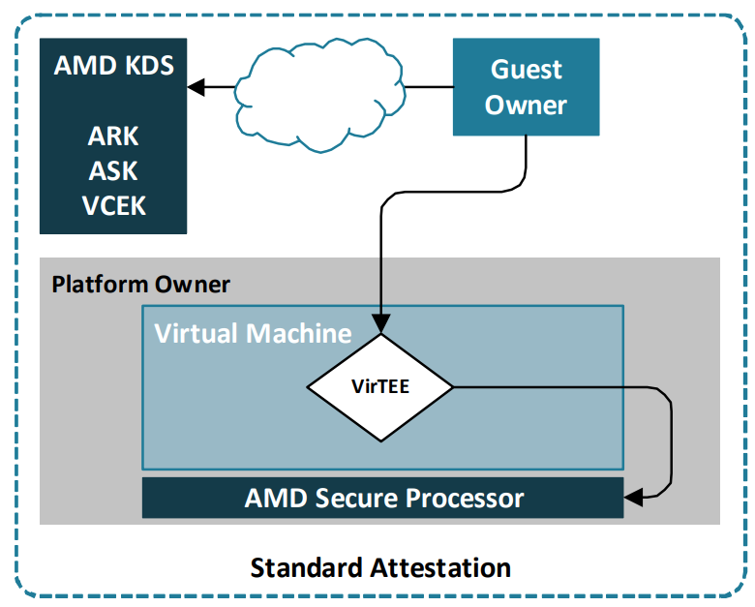
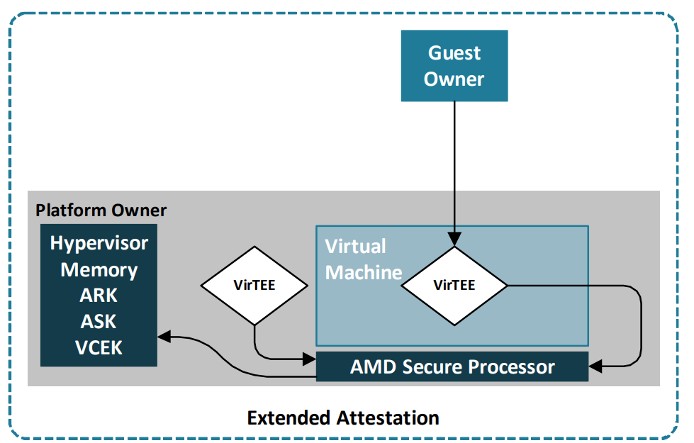
Project VirTEE
https://github.com/virtee/snpguest
Rust library and Multitool for AMD SEV-SNP
For more info, go to: https://developer.amd.com/sev
Standard Attestation: Guest owners may request a standard attestation report. This process involves pulling the certificate-chain from the AMD Key Distribution Server (KDS) in accordance with the VCEK Specification.
Extended Attestation: Guest owners may request an extended attestation report. In this case, virTEE takes over the task of storing certificate-chains in the hypervisor memory. This eliminates the need for manual requests to the AMD KDS, reduces dependence on external operations.

Slide 62
AMD SEV-SNP – Links & Downloads
Link | Description
https://github.com/AMDESE/AMDSEV | Setup scripts useful for running SEV guests. Site also hosts Linux open source code under development (note SEV support has been accepted in upstream projects)
Using AMD Secure Memory Encryption with Oracle Linux | Oracle UEK support for SME and SEV.
SUSE: AMD Secure Encrypted Virtualization (AMD-SEV) Guide | Provides a basic understanding of how SEV works, how to enable and configure it, and some of the limitations and restrictions that its use causes as compared to non-encrypted virtualization.
ask_ark_naples.cert | ASK/ARK certificates for EPYC 7xx1 (Naples)
ask_ark_rome.cert | ASK/ARK certificates for EPYC 7xx2 (Rome)
ask_ark_milan.cert | ASK/ARK certificates for EPYC 7xx3 (Milan)
ask_ark_genoa.cert | ASK/ARK certificates for EPYC 9xx4 (Genoa)
amd_sev_fam17h_model01h_0.17.48.zip | SEV Firmware | SEV firmware 0.17.48 [hex 00.11.30] for EPYC 7xx1 (Naples)
amd_sev_fam17h_model3xh_0.24.15.zip | SEV Firmware | SEV firmware 0.24.15 [hex 00.18.0F] for EPYC 7xx2 (Rome)
amd_sev_fam19h_model0xh_1.54.01.zip | SEV Firmware | SEV firmware 1.54.01 [hex 1.36.01] for EPYC 7xx3 (Milan)
CEK certificate web page | Interactive tool for obtaining CEK certificate. Also available as https://kdsintf.amd.com/cek/id/<GetIDValue>
https://github.com/AMDESE/sev-tool | AMD SEV Tool for managing SEV platform certificates
https://github.com/AMDESE/runtime | SEV runtime for Kata Containers
https://www.amd.com/en/developer/sev.html
Notes:
$ sudo dmesg | grep SEV

Slide 63
Hands-on lab: Generating and validating attestation report

Slide 64
Hands-on lab will cover – cvm_attestation.ipynb
Highlighting essential claims extracted from Microsoft Azure Attestation, including details of the Azure confidential VM and its configuration parameters.
Validating the JWT's signature through attestation signature validation using a Python script. This validation involves comparing the calculated SHA-256 hash with the decrypted signature.
Introducing a helper application for remote attestation using a web API. This application facilitates the setup and retrieval of attestation by requesting it from the VM and displaying the JWT token.
Notes:
Hands-on lab: Deploying Confidential VM – cvm_attestation.ipynb

Slide 65
Hands-on lab will cover - cvm_attestation_deepdive.md
Manually fetching and verifying a raw sev-snp report
Installing the tpm2-tss firmware
Extracting the VCEK certificate from a CVM
Using the virtee/snpguest tool to validate the report
Notes:
Hands-on lab: Deploying Confidential VM - cvm_attestation_deepdive.md
virtee/snpguest: A CLI tool for interacting with SEV-SNP guest environment (github.com)

Slide 66
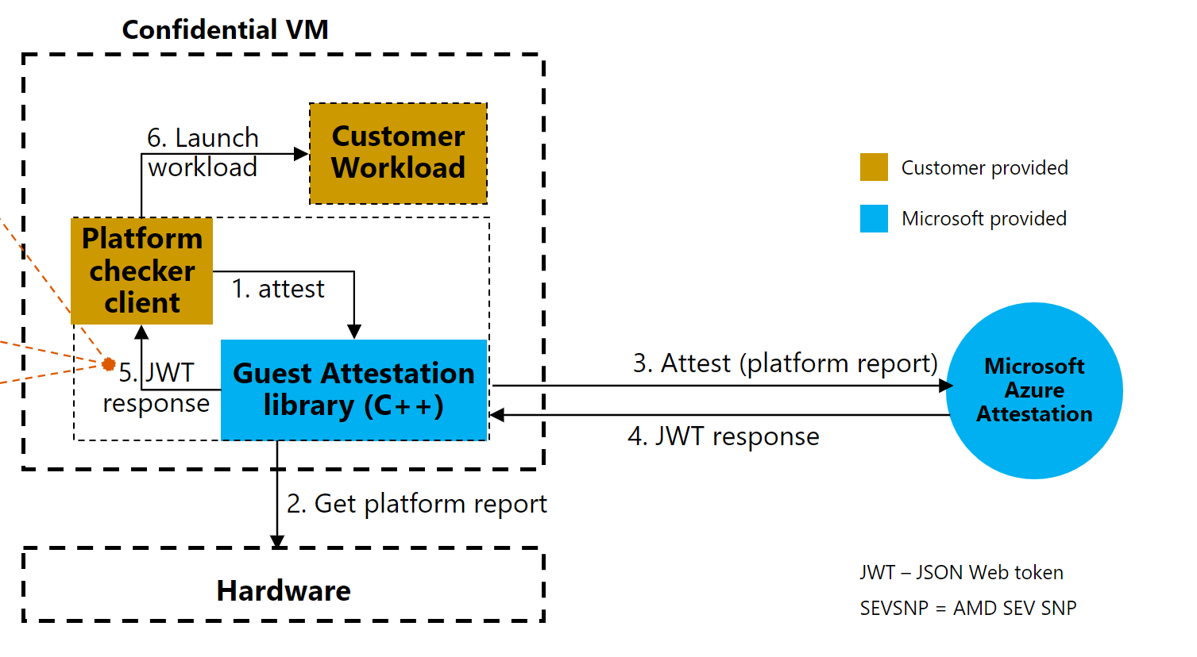
What is guest attestation for confidential VMs?
Scenario Overview: In this specific scenario, attestation requests are isolated in a separate workload. These requests aim to verify if the confidential VM is running on the accurate hardware platform prior to launching any workload.
The Role of Workload: A workload, represented as Platform checker client in the scenario diagram, is required to integrate with the attestation library. This workload runs within the confidential VM and carries out the attestation.
Attestation Request and Response: The platform checker client initiates a request to the attestation library. Post this, the response received is parsed by the workload.
Final Verification: The parsing of the response allows the workload to confirm if the VM is operating on the appropriate hardware platform and/or secure boot setting. This verification is critical and must be completed prior to launching the sensitive workload.
https://github.com/Azure/confidential-computing-cvm-guest-attestation

Slide 67
SEV-SNP attestation example generated by Microsoft Azure Attestation
{
"iss": "https://sharedeus2.eus2.test.attest.azure.net",
"jti": "7afd308c493bac16b980be4f73d479be982306a6790fcf19a68a5f77528b5504",
"nbf": 1680702867,
"nonce": "13104315944768644014",
"x-ms-attestation-type": "sevsnpvm",
"x-ms-compliance-status": "azure-compliant-uvm",
"x-ms-policy-hash": "9NY0VnTQ-IiBriBplVUpFbczcDaEBUwsiFYAzHu_gco",
"x-ms-sevsnpvm-authorkeydigest": "000000000000000000000000000000000000000000000000000000000000000000000000000000000000000000000000",
"x-ms-sevsnpvm-bootloader-svn": 3,
"x-ms-sevsnpvm-familyId": "01000000000000000000000000000000",
"x-ms-sevsnpvm-guestsvn": 2,
"x-ms-sevsnpvm-hostdata": "42d3ea021f6fbd2e1ce5bc1470ee127673e349b9be815ef87e585a8f8fe2e8d7",
"x-ms-sevsnpvm-idkeydigest": "cf7e12541981e6cafd150b5236785f4364850e2c4963825f9ab1d8091040aea0964bb9a8835f966bdc174d9ad53b4582",
"x-ms-sevsnpvm-imageId": "02000000000000000000000000000000",
"x-ms-sevsnpvm-is-debuggable": false,
"x-ms-sevsnpvm-launchmeasurement": "a1e1a4b64e8de5c664ceee069010441f74cf039065b5b847e82b9d1a7629aaf33d5591c6b18cee48a4dde481aa88d0fb",
"x-ms-sevsnpvm-migration-allowed": false,
"x-ms-sevsnpvm-reportdata": "7ab000a323b3c873f5b81bbe584e7c1a26bcf40dc27e00f8e0d144b1ed2d14f10000000000000000000000000000000000000000000000000000000000000000",
"x-ms-sevsnpvm-reportid": "aaf081e18d64bca741bc5bbcebb6f0493d014b442f030a709979442d4ebcae6a",
}

Slide 68
SEV-SNP attestation evidence from Microsoft Azure Attestation
Name | Meaning
x-ms-sevsnpvm-authorkeydigest | The SHA384 hash of the author signing key
x-ms-sevsnpvm-bootloader-svn | The AMD boot loader security version number (SVN)
x-ms-sevsnpvm-familyId | The HCL family identification string
x-ms-sevsnpvm-guestsvn | The HCL security version number (SVN)
x-ms-sevsnpvm-hostdata | Arbitrary data defined by the host at VM launch time
x-ms-sevsnpvm-idkeydigest | The SHA384 hash of the identification signing key
x-ms-sevsnpvm-imageId | The HCL image identification
x-ms-sevsnpvm-is-debuggable | Boolean value indicating whether AMD SEV-SNP debugging is enabled
x-ms-sevsnpvm-launchmeasurement | Measurement of the launched guest image
x-ms-sevsnpvm-microcode-svn | AMD microcode security version number (SVN)
x-ms-sevsnpvm-migration-allowed | Boolean value indicating whether AMD SEV-SNP migration support is enabled
x-ms-sevsnpvm-reportdata | CVM: Data passed by HCL to include with report, to verify that transfer key and VM configuration are correct
x-ms-sevsnpvm-reportid | Report ID of the guest
x-ms-sevsnpvm-smt-allowed | Boolean value indicating whether SMT is enabled on the host
x-ms-sevsnpvm-snpfw-svn | AMD firmware security version number (SVN)
x-ms-sevsnpvm-tee-svn | AMD trusted execution environment (TEE) security version number (SVN)
x-ms-sevsnpvm-vmpl | VMPL that generated this report (0 for HCL)
Note: Definitions based on Azure “confidential VM” use of SEV-SNP attestation

Slide 69
Attestation claim details
Claim | Description | Usage and verification | Data size/example
x-ms-attestation-type | Type of processor | Is it running on a genuine AMD sev-snp hardware? | sevsnpvm
x-ms-compliance-status | Type of vm | Is it an azure compliant confidential vm? | azure-compliant-cvm
x-ms-sevsnpvm-hostdata | sha256 hash digest of the security policy | Is the workload what I expect it to be? | 256 bits
x-ms-sevsnpvm-launchmeasurement | sha-384 digest of utility VM’s launch measurement | Is the initial state of the memory, correct? | 384 bits
x-ms-sevsnpvm-reportdata | When the guest asks for a report, it supplies 512 bits of arbitrary data to be included in the report as ReportData. | Is the data provided by the hypervisor at launch, correct? | 512 bits

Slide 70
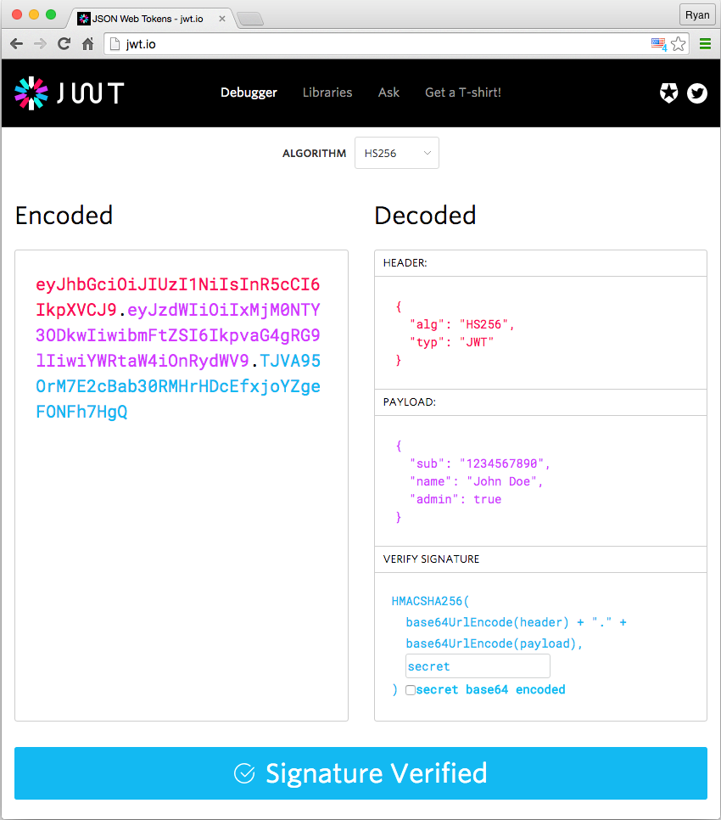
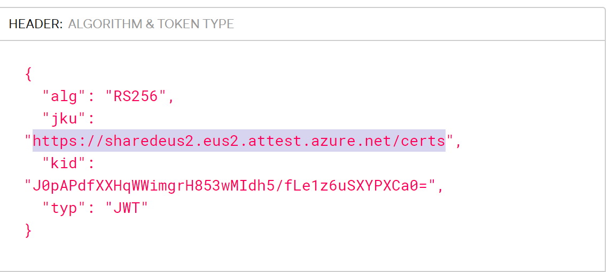
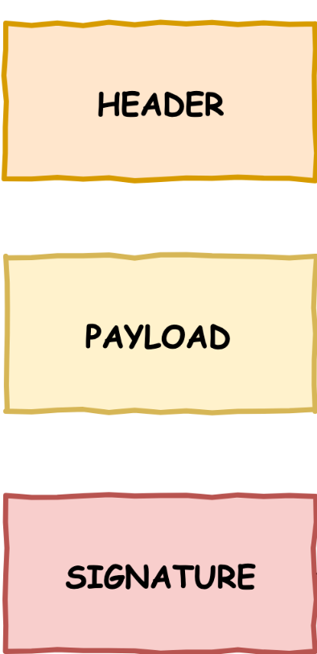
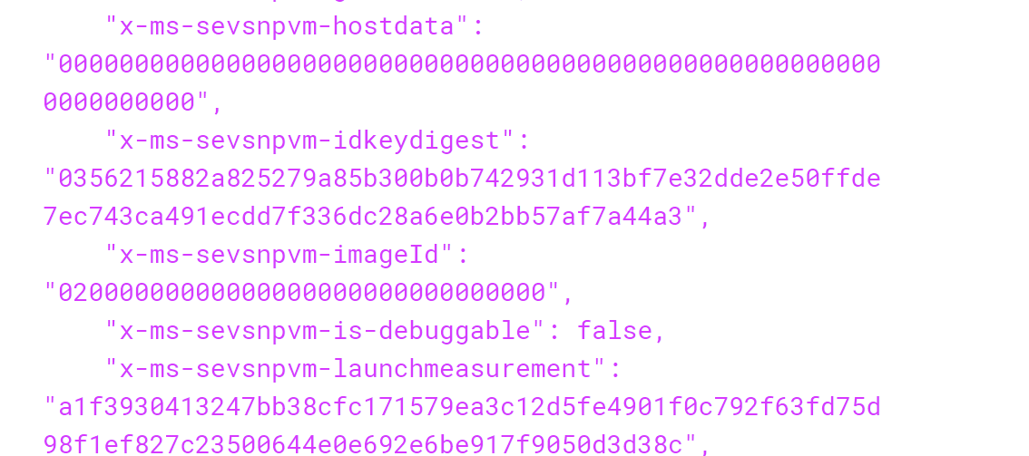
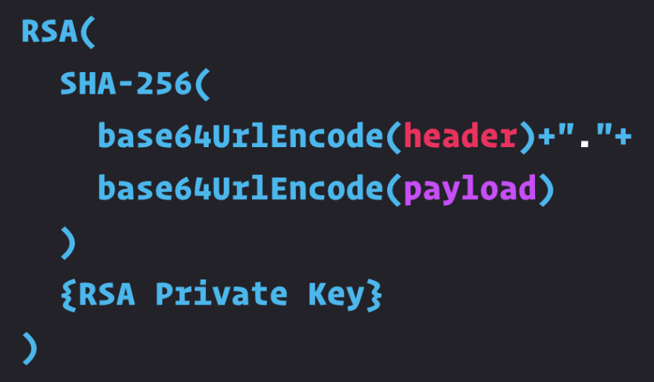
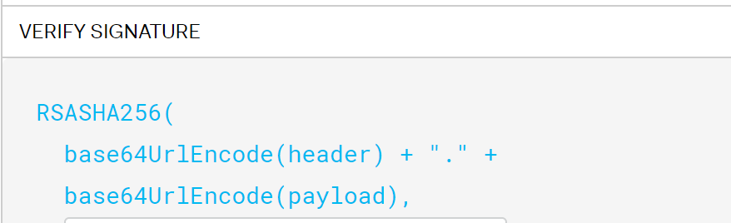
Validating JSON Web Tokens (JWT)
Notes:
https://dev.to/kimmaida/signing-and-validating-json-web-tokens-jwt-for-everyone-25fb
https://certificatedecoder.dev/
AMD SEV Support · Issue #4630 · openenclave/openenclave (github.com)

Slide 71
Signature Verification steps
Extract the JWT header, payload, and signature segments
Base64url decode each segment and convert to bytes
Concatenate the JWT header and payload segments with a period delimiter
Calculate the SHA-256 hash of the JWT Signing Input
Load the public key from the x509 certificate
Verify the RSA signature
Compare the hex representations of digest and decrypted signature

Slide 72
Confidential Containers on Azure Containers Instances

Slide 73

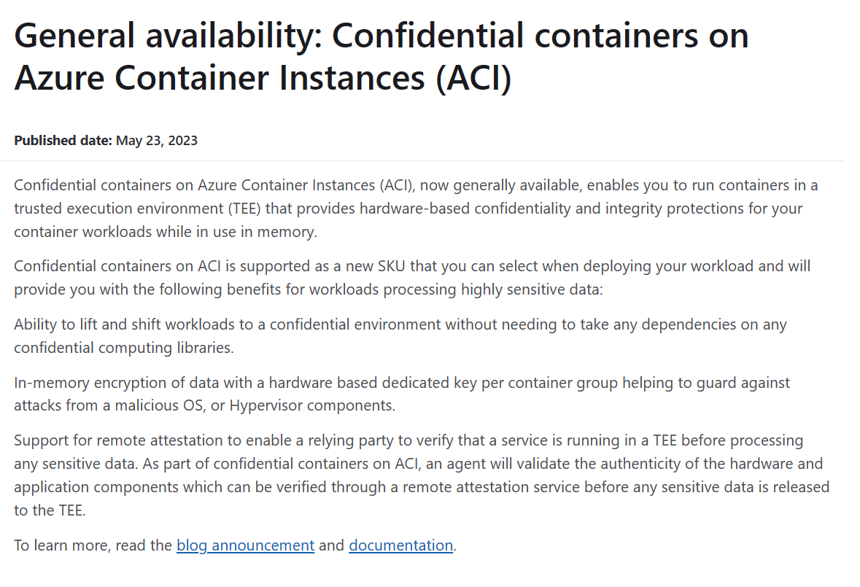







Confidential Containers on ACI
Confidential containers on Azure Container Instances (ACI)
Azure Container Instances
GENERALLY AVAILABLE
No infrastructure management
Run any image or language framework
Pay per second billing
ACI is leveraging Open GCS.
Confidential Computing Consortium
Confidential Containers (github.com)
Kata Containers - Open Source Container Runtime Software | Kata Containers
Open Guest Compute Service – Azure Container Instances.
Notes:
https://azure.microsoft.com/en-us/updates/general-availability-confidential-containers-on-azure-container-instances-aci/
Open GCS (Open Guest Compute Service) is a Linux open-source project that aims to further the development of a production-quality implementation of Linux Hyper-V containers on Windows (LCOW). It is designed to run inside a custom Linux OS for supporting Linux container payloads Reference: OC3 Conference - Confidential containers and configuration integrity https://www.youtube.com/watch?v=yaLoq5POv8Q

Slide 74
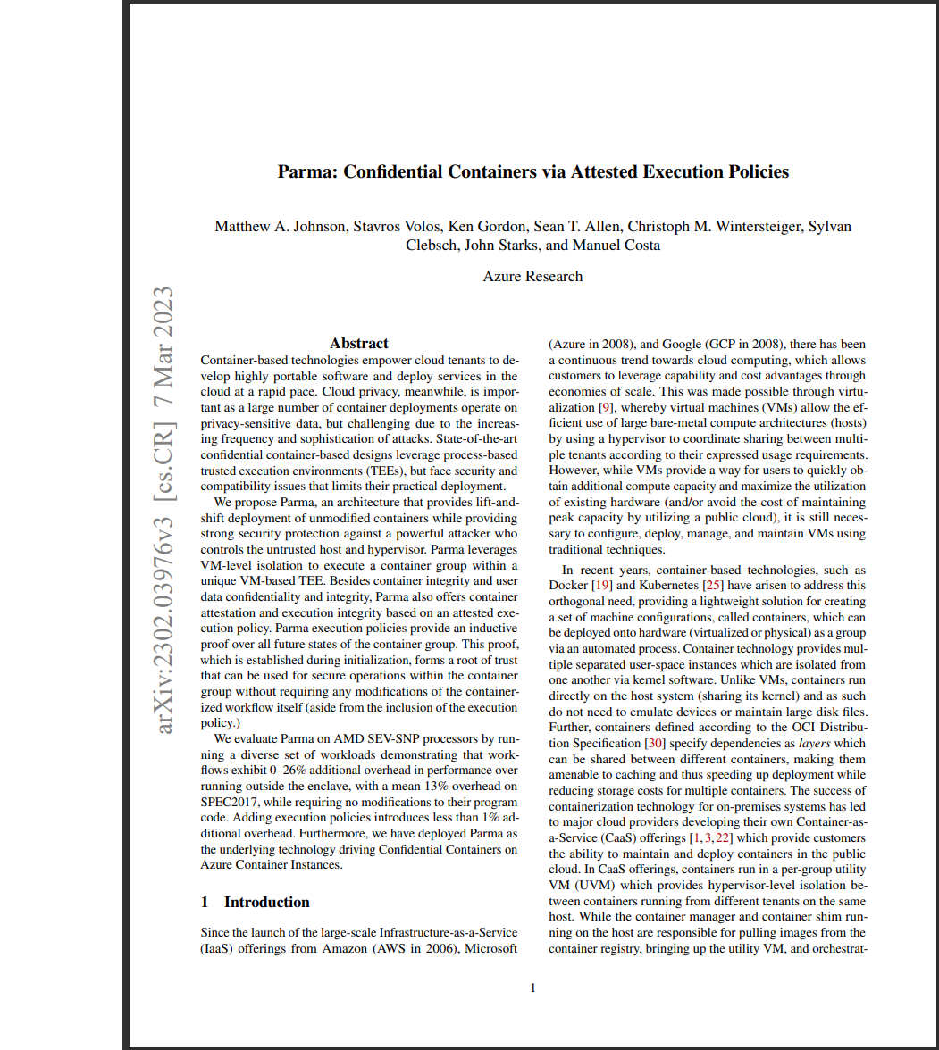
Parma
Parma is an architecture that provides lift-and-shift deployment of unmodified containers while providing strong security protection against a powerful attacker who controls the untrusted host and hypervisor.
Parma, a novel security architecture for confidential containerized workloads, establishes security guarantees rooted in an inductive proof over all future states of the container group provided by the introduction of an attested execution policy.
The execution policy is a component of the utility VM that is attested at initialization time, describing all of the actions the user has explicitly allowed the guest agent to take within the container group. When a hash does not match, this action is denied.
The guest agent coordinates the container workflow as directed by the host-side container shim and is augmented to enforce the execution policy such that it only executes commands (submitted by the untrusted container shim) explicitly allowed by the user.
Parma leverages VM-level isolation to execute a container group within a unique VM-based TEE, offering container integrity and user data confidentiality and integrity, as well as container attestation and execution integrity based on an attested execution policy.
Parma provides strong protection for the container’s root filesystem (comprised of the container image layers and writeable scratch space) and the user’s data through block-level encryption and integrity (using dm-crypt + dm-integrity).
The implementation of Parma forms the basis for Confidential Containers on Azure Container Instances and is publicly available on GitHub hcsshim system, neither requiring changes to existing containers nor container image signing.
Confidential Containers via Attested Execution Policies

Slide 75




ACI Trusted execution environment
Container Group
Customers can lift and shift existing container images while receiving in-memory encryption and attestation
Each container group is isolated through Hyper-V
Hardware-based memory encryption with a key per container group
Container code and config integrity protection and immutable container groups
Integrated platform sidecars to make it easy to perform remote attestation measuring all hardware and software components
Customer’s app
Platform integrated remote attestation
Container images
Attestation sidecar
Encrypted memory
(Confidentiality & Integrity)
Hypervisor, OS, Device Drivers, …
Hardware
Notes:
Reference: OC3 Conference - Confidential containers and configuration integrity https://www.youtube.com/watch?v=yaLoq5POv8Q
Two open-source sidecars to support confidential functionality within the container group: Secure key release sidecar and Encrypted file system sidecar
https://github.com/microsoft/confidential-sidecar-containers

Slide 76
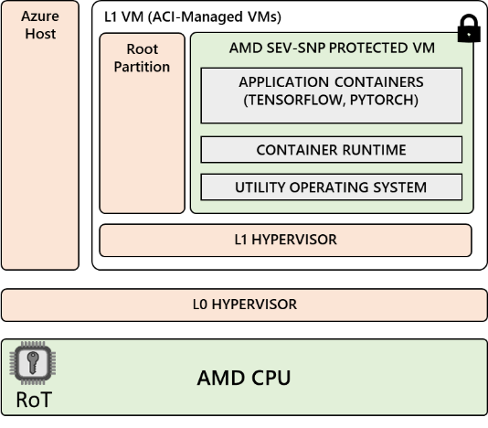



Confidential Containers on ACI
Common Confidential ACI workloads
Confidential Data processing
Confidential ml training
(non-AML)
Confidential Micro-Service api/function
Crypto Operations Container Securing
Multi-party confidential analytics
Confidential containers on ACI

Slide 77
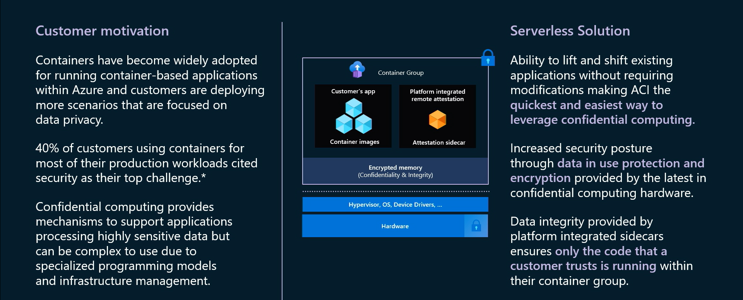
Confidential Containers on ACI

Slide 78
Attestation evidence for verification
Containers + Container Config
Report_Data: Your code and configs
Container Runtime + Platform Software
Container Guest OS
Host_Data: Platform code and configs
AMD Milan SEV-SNP
Notes:
Reference: OC3 Conference - Confidential containers and configuration integrity https://www.youtube.com/watch?v=yaLoq5POv8Q

Slide 79
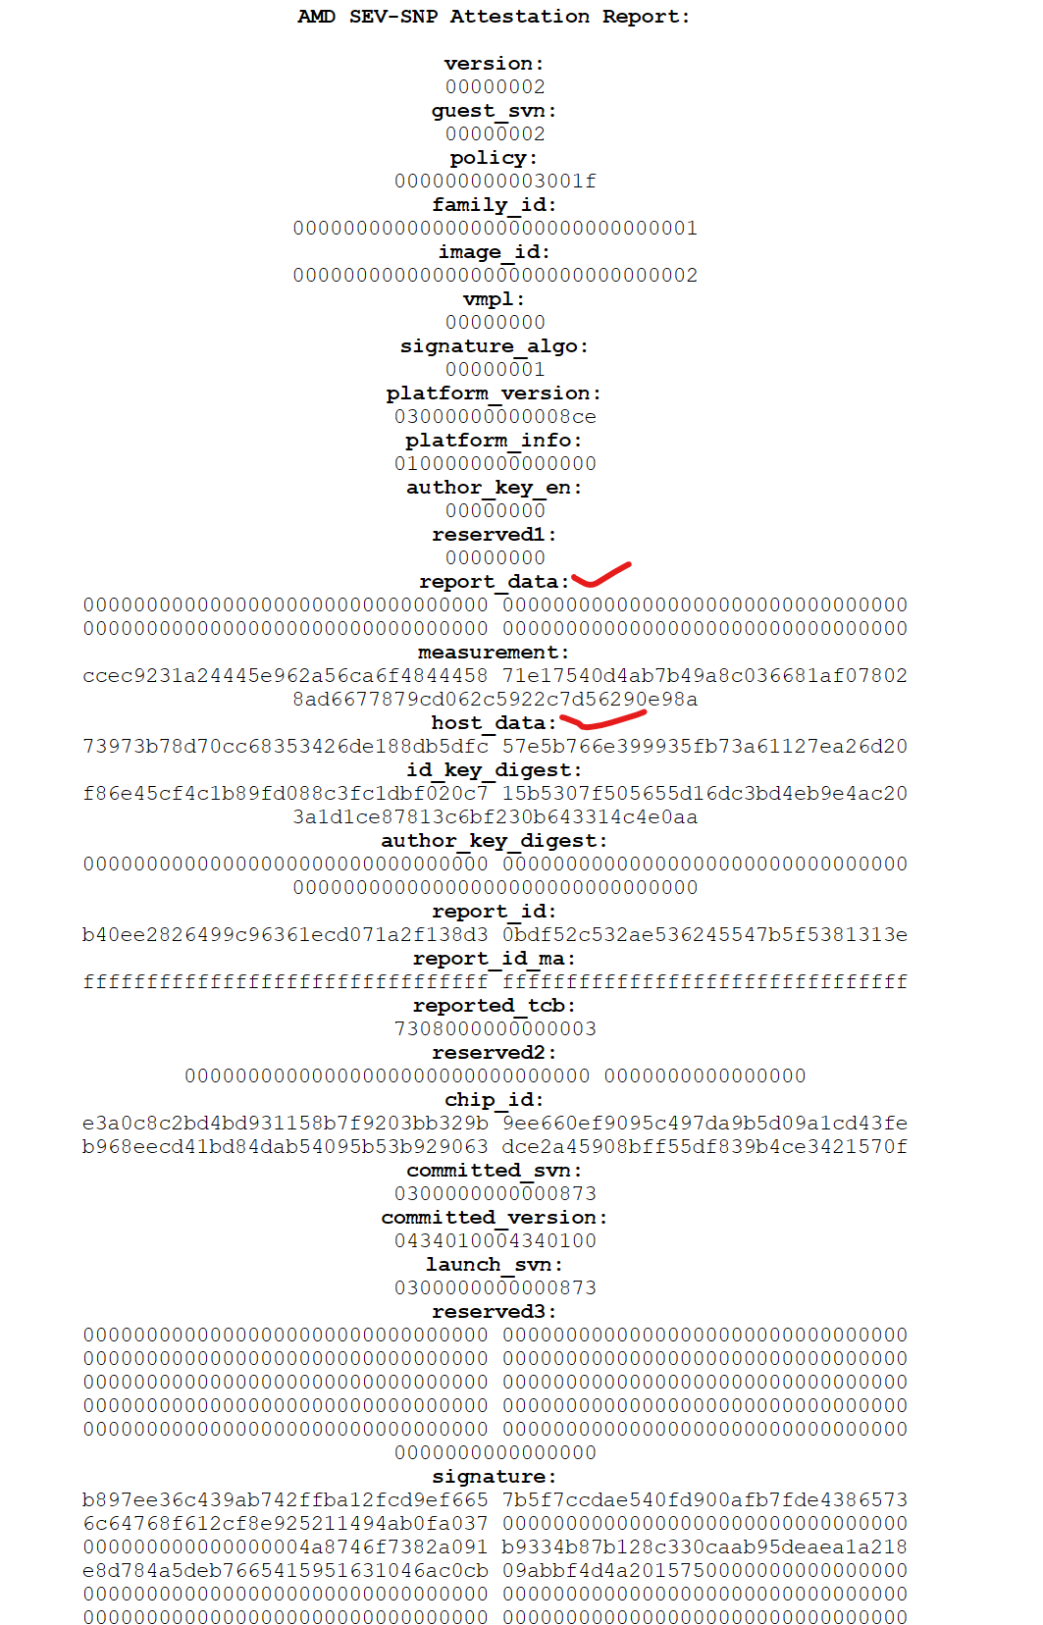
Example Raw SNP report & Microsoft Azure Attestation Quote
{
"alg": "RS256",
"jku": "https://sharedeus2.eus2.attest.azure.net/certs",
"kid": "J0pAPdfXXHqWWimgrH853wMIdh5/fLe1z6uSXYPXCa0=",
"typ": "JWT"
}
{
"exp": 1664193003,
"iat": 1664164203,
"iss": "https://sharedeus2.eus2.attest.azure.net",
"jti": "768f851235c78616ee6a0f59a82dc69b8e70770c3339b34117b729cdc91ddebd",
"nbf": 1664164203,
"secureboot": true,
"x-ms-attestation-type": "azurevm",
"x-ms-azurevm-attestation-protocol-ver": "2.0",
"x-ms-azurevm-attested-pcrs": [
0,
1,
2 ],
"x-ms-azurevm-bootdebug-enabled": false,
"x-ms-azurevm-dbvalidated": true,
"x-ms-azurevm-dbxvalidated": true,
"x-ms-azurevm-debuggersdisabled": true,
"x-ms-azurevm-default-securebootkeysvalidated": true,
"x-ms-azurevm-elam-enabled": false,
"x-ms-azurevm-flightsigning-enabled": false,
"x-ms-azurevm-hvci-policy": 0,
"x-ms-azurevm-hypervisordebug-enabled": false,
"x-ms-azurevm-is-windows": false,
"x-ms-azurevm-kerneldebug-enabled": false,
"x-ms-azurevm-osbuild": "NotApplication",
"x-ms-azurevm-osdistro": "Ubuntu",
"x-ms-azurevm-ostype": "Linux",
"x-ms-azurevm-osversion-major": 18,
"x-ms-azurevm-osversion-minor": 4,
"x-ms-azurevm-signingdisabled": true,
"x-ms-azurevm-testsigning-enabled": false,
"x-ms-azurevm-vmid": "B958DC88-E41D-47F1-8D20-E57B6B7E9825",
"x-ms-isolation-tee": {
"x-ms-attestation-type": "sevsnpvm",
"x-ms-compliance-status": "azure-compliant-uvm",
"x-ms-runtime": {
Notes:
Reference: OC3 Conference - Confidential containers and configuration integrity https://www.youtube.com/watch?v=yaLoq5POv8Q

Slide 80
Trust Chain
Launch Process:
1. Hardware measures the container group software stack at container group creation time and captures the hash of the security policy.
2. The OpenGCS agent ensures that only “allowed” containers with “allowed” configurations can be loaded in reference to the security policy.
Container Group
Containers
Attestation Process:
1. Software requests Attestation evidence from the hardware.
2. Hardware generates attestation evidence with the measurement and security policy hash which is signed by a private key that is only accessible by the TEE hardware.
3. Verify attestation evidence signature
If failed, attacker might have created fake attestation evidence
4. Check UVM image measurement against the expected value in Secret Release Rule
If not matching, attacker might have created the UVM with a different software stack image
5. Check security policy hash against the expected value
If not matching, attacker might have fed OpenGCS with a spoofed security policy
OpenGCS
Linux Kernel, runc, etc.
Hypervisor, OS, Device Drivers, …
Hardware

Slide 81



Policy enforced trusted execution environment
SW requests an Attestation Evidence from the HW
HW generates Attestation Evidence, with the measurement and Security Policy hash, signed by a private key only accessible by the TEE HW
UVM
Attestation Evidence
Secret Release Rule – UVM image measurement plus CCE Policy hash
Containers
OpenGCS makes sure only “allowed” containers with “allowed” configuration can be loaded in reference to the CCE Policy (Allowed List)
Verify Attestation Evidence’s signature
If failed, attacker might have created a fake Attestation Evidence
Check UVM image measurement against the expected value in Secret Release Rule
If not matching, attacker might have created the UVM with a different SW stack image
Check CCE Policy hash against the expected value
If not matching, attacker might have fed OpenGCS with a spoofed CCE Policy
OpenGCS
CCE Policy
(allowed list)
Linux Kernel, runc, etc.
HW measure the UVM SW stack at UVM creation time; the HW also captures the hash of the CCE Policy
Hyper-V
Hardware

Slide 82
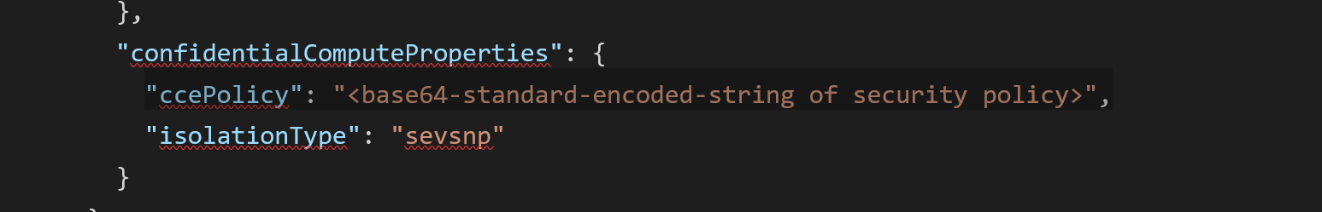

Enforce code integrity through customer defined policies
Confidential computing enforcement (CCE) policy
Confidential computing enforcement policies are generated by the Azure CLI confcom extension.
Enforced by OpenGCS
Which containers are permitted to run in the utility VM along with the hashes of each layer filesystem of the container image,
What command lines can be used as entry point,
The permitted environment variables and their values,
Whether a container is allowed to run as privileged.
Container images
Environment variables
Logging
Volume mounts
Container privileges
Notes:
CCE: Confidential Computing Enforcement (CCE) policies https://github.com/Azure/azure-cli-extensions/tree/main/src/confcom/azext_confcom

Slide 83
CCE Policy Validation in ACI Deployment
Customer runs a CLI tool on the deployment template to get an output of the CCE policy and then calls the create ACI call with the deployment template and policy. The CCE policy is ultimately a representation the following:
Container image & configuration parsed from the deployment template
Side Cars (fragments) that ACI will insert next to their container based on the deployment template
At the time of deployment ACI will validate this incoming CCE policy with what it parses from the deployment template and only proceed if both match. If the customer tries to edit this policy (e.g. removing side cars) the deployment will fail. Which means the customer either takes the policy as is or leaves it.
Side cars are represented in the policy via Fragments.

Slide 84

Generating confidential computing enforcement policies
JSON document defines what is allowed to run within the TEE
Policy JSON
CLI tooling takes the JSON document as input and calculates a policy which can be enforced by Open GCS
Confcom CLI
The policy is outputted as a base 64 string containing all the properties that need to be validated at container launch time
Base 64 String
The base 64 string is added to the CCE property of the container group which is now ready for deployment
ARM Template
Notes:
Confcom CLI: azure-cli-extensions/README.md at main · Azure/azure-cli-extensions (github.com)

Slide 85
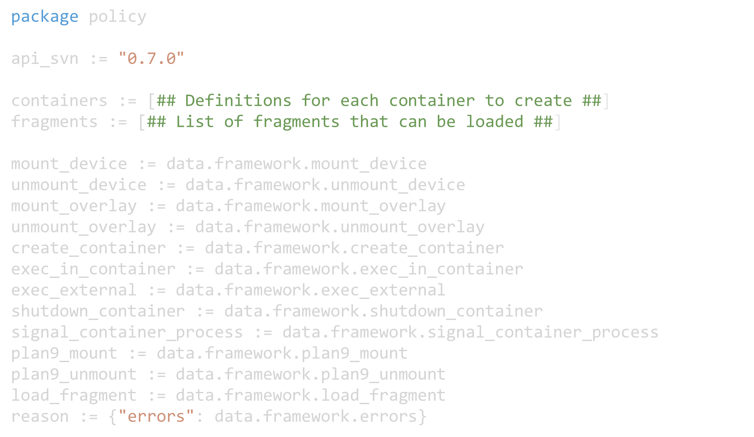
Sample CCE Policy from ConfCom CLI
Created by CLI tool, based on Container images and Conf. Specified in ARM Template
Inserted by CLI tool
Inserted by CLI tool

Slide 86
Sample CCE policy – More Details
"ccePolicy": "package policy
import future.keywords.every
import future.keywords.in
api_version := \"0.10.0\"
framework_version := \"0.2.3\„
fragments:= {\"feed\": \"mcr.microsoft.com/aci/aci-cc-infra-fragment\", \"includes\": ["containers\",\"fragments\"],\"issuer\":\"did:x509:0:sha256:I__iuL25oXEVEFdTP_aBLx_eT1RPHbCQ_ECBQbFYZpt9s::eku:1.3.6.1.4.1.311.76.59.1.3\",\"minimum_svn\": \"1\"}
containers:= [
{"allow_elevated":false,
"command":["/bin/sh","-c","node /usr/src/app/index.js"],
"env_rules":[
{"rule":"PATH=/usr/local/sbin:/usr/local/bin:/usr/sbin:/usr/bin:/sbin:/bin","strategy":"string"},
{"rule":"azurecontainerinstance_restarted_by=.+","strategy":"re2"}
],
"id":“samplesnpregistry.azurecr.io/custom-aci-hello:4g",
"layers":["c6d324ab16cc7589e917c706b19a1137f7835d2c77b4604c28f9494dd8b60959",” c6d324ab16cc7589e917c706b19a1137f7835d2c77b4604c28f9494dd8b60959”}],
"working_dir":"/usr/src/app“}]
“name”
Signing key digest
Min. SVN
DM-Verity measurements of the container layers

Slide 87
CCE Policy
CCE Policy is created from the deployment template to give customer full visibility into how ACI will provision the container from the deployment template
The policy defines the entities and constraints that are allowed in a confidential execution environment. The policy contains the customer workload containers and their layers, mount information, and system sidecar’s config/identity via fragment references. This policy is required for all confidential container groups created in ACI. The policy is enforced by the OpenGCS after the start of the UVM and helps in achieving full attestation of the customers TEE.
CCE Policy contains the following main parts (all extracted from the deployment template)
Fragment REGO representing the side car
fragment feed (pointing to the MCR location containing the side car details)
SVN on the fragment (min version)
Public Key of the Fragment (to allow customer to audit the signing)
Customer Images & Layers
Environment Variables
Mounts
Execution Commands
When the CCE Policy reaches the lower layers in ACI, OpenGCS will validate that the policy matches what ACI is attempting to execute. Only if the actions match the policy the container will be created. This means if the customers tries to edit the policy (add/ remove side cars as an example), it will be rejected.

Slide 88
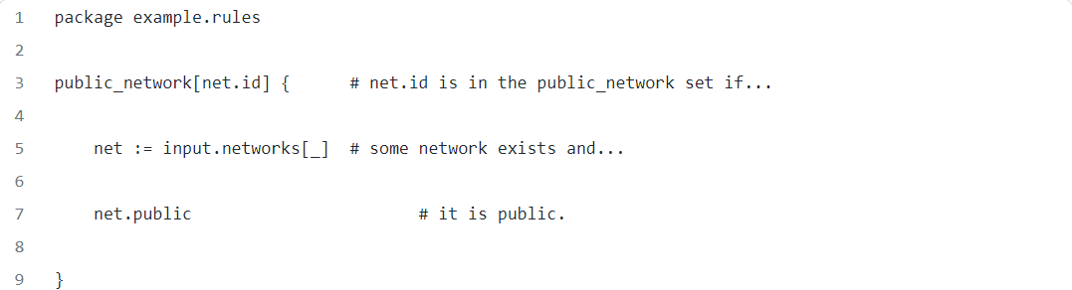
What is Rego?
Fragments are represented by Rego in the CCE Policy
Rego Sample
Rego is the purpose-built declarative policy language that supports Open Policy Agent (OPA). It’s used to write policy that is easy to read and easy to write. Fundamentally, Rego inspects and transforms data in structured documents, allowing OPA to make policy decisions.
Rego was originally inspired by Datalog to support structured document models like JSON. , a common query language with a decades-long history, but extends its capabilities

Slide 89
Confidential containers on ACI Example
Container Host (Azure Host or Azure VM)
Confidential Utility VM
Deploy Container + Config
Scratch disk
OverlayFS
rw vhd
dm-crypt + dm-integrity
Included in policy
4
Attach disks
5
6
runc
OCI Image Layers
Dm-verity RO disks
dm-verity lower layers
Verify policy
Run Container
Layer 0
ro vhd 0
ro vhd n
Open Guest Compute Service (OpenGCS)
Layer n
Included in hardware report
POLICY: dm-verity root hashes
POLICY: dm-verity root hashes
Direct Linux Boot
1
Convert layers into dm-verity integrity protected VHDs
2
Generate policy, includes ordered list of dm-verity root hashes
3
Launch confidential UVM with container runtime and immutable policy
Hypervisor
CPU BIOS, Device Drivers, …
Hardware
Notes:
Reference: OC3 Conference - Confidential containers and configuration integrity https://www.youtube.com/watch?v=yaLoq5POv8Q

Slide 90
Attestation schemes supported in ACI
Platform Guest Attestation
Remote attestation to help validate the hardware supporting the AMD SEV-SNP ACI instance
Guest applications can tap into the Microsoft Azure Attestation service to attest the TEE’s validity
Advanced Guest Workload Attestation
Reflects customers workload in the attestation report
TCB measures the launch policy which is then hardware report
Code integrity is maintained through DM Verity hash and launch enforcements
Additional claims around launch parameters etc. through CCE policy

Slide 91
Confidential Sidecar container
Container Group
Integrated platform sidecars to make it easy to perform remote attestation measuring all hardware and software components
Secure key release (SKR) sidecar
Encrypted filesystem sidecar
https://github.com/microsoft/confidential-sidecar-containers/
Customer’s app
Sidecar containers
Container images
confidential sidecar
Encrypted memory
(Confidentiality & Integrity)
Hypervisor, OS, Device Drivers, …
Hardware

Slide 92
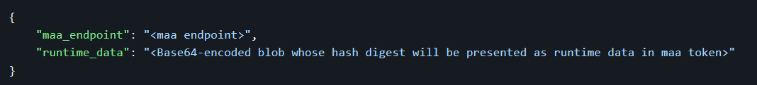
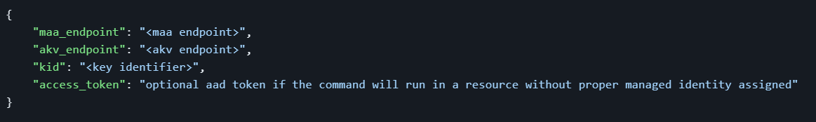
Secure Key Release (SKR) sidecar
REST API - https://github.com/microsoft/confidential-sidecar-containers/blob/main/cmd/skr/README.md
POST method | Description | JSON expected
attest/raw | The POST method attest/raw returns the hardware attestation report in hexstring format. It expects a JSON of the following format.
attest/maa | The POST method attest/maa interacts with Microsoft Azure Attestation service to receive a JSON Web Token that represents the attestation report as a collection of claims. It expects a JSON of the following format.
key/release | The POST method key/release interacts with AKV MHSM service to release a key previously imported to the managed HSM. It expects a JSON of the following format.

Slide 93
Encrypted filesystem sidecar
OCI images are integrity protected but not encrypted.
Customers provide encrypted data (which may include code/binaries) by using tooling to:
Build an encrypted and integrity protected VHD containing their data.
Store the VHD in Azure Blob Storage.
Provision the customer DEK to an Azure key management system (MHSM, etc.) along with a tooling-generated secure key release (SKR) policy that allows only their VM Confidential Container to receive the DEK.
Parma
HW report -> MAA token
MAA
Isolated Guest OS
Key Management
Policy: root hashes
MAA token -> DEK
OpenGCS
Overlay FS
runc
SKR Policy
Customer DEK
dm-crypt + dm-integrity
Azure Storage
blobfuse
Customer FS

Slide 94
Hands-on lab
ACI

Slide 95
Hands-on lab will cover - confidential_containers_cce.md
Creating an ARM template for deploying ACI with a confidential computing environment.
Introducing the CCE policy with defined rules enforced in the utility VM.
Installing the required Azure CLI extension: az confcom.
Generating the CCE policy: az confcom acipolicygen -a ./template.json --print-policy.
Adding the generated CCE policy to the ARM template under the ccePolicy property.
Logging into Azure and accessing "Deploy a custom template".
Observing the attestation report as proof of confidential computing deployment.
Notes:
Hands-on lab: Deploying Confidential VM - confidential_containers_cce.md

Slide 96
Hands-on lab will cover - confidential_containers_attestation_deepdive.md
Deploying a confidential container on ACI
Connecting to the confidential container
Using the sidecar-containers to retrieve a report attestation
Using the virtee/snpguest to validate the signature of the report
Notes:
Hands-on lab: confidential_containers_attestation_deepdive.md

Slide 97
Hands-on lab will cover – confidential_containers_cce_deepdive.ipynb
Deploying the container group using the ARM template.
Checking for successful deployment and obtaining the attestation token:
- Verify the successful deployment.
- Compare the security policy hash in the attestation token.
Stopping the container.
Deploying a different image than what is specified in the security policy:
- Deploy a container image that calculates the product of two numbers.
- The deployment will be denied by the security policy.
Restarting the container:
- The deployment will fail due to the image not matching the security policy.
Deploying an updated image with an updated security policy:
- Generate a new security policy and update the ARM template.
Checking deployment success and obtaining the attestation token:
- Verify the deployment success.
- Compare the security policy hash in the attestation token.
Notes:
Hands-on lab: Deploying Confidential VM - confidential_containers_cce_deepdive.ipynb

Slide 98
Confidential Containers on AKS

Slide 99



Kata Confidential containers on AKS
Confidential Containers on AKS run in dedicated “child VMs” per pod.
Enhanced Application Isolation: Running Kubernetes pods at this isolation level using nested virtualization provides app isolation from the parent VM and the tenant OS admin.
Flexible Workload Support: It accommodates the need of natively running any Linux container, promoting a diverse workload ecosystem.
Kata Confidential Containers (CoCo): This open-source sandboxed CNCF project provides an ideal set of building blocks and security constructs for broad Kubernetes workload support.
Augmented Data Protection:
Protects data from potential threats from your Azure tenant admin or Kubernetes admin.
Safeguards data from the cloud provider/operator, ensuring enhanced data security.
Azure Kubernetes Service
Kata Confidential containers on AKS
SIGN-UP for PREVIEW
Isolate containers from k8s admin
Run any containerized app
Open source, building on Kata containers
Aka.ms/cocoakspreview
Notes:
Reference: Kata confidential containers with Azure Kubernetes Service (AKS) (microsoft.com) Question: Are new Azure VM sizes needed to run this feature on AKS? Answer: Yes. New Confidential computing capable child VM sizes DCA_CC_v5, ECA_CC_v5 are needed to use this feature

Slide 100
Kata Confidential Containers
AKS Control Plane
Scenarios/Use cases
Big Data Analytics: Employing privacy-preserving analytics in the banking sector, such as Apache Spark jobs for fraud pattern recognition, while ensuring data confidentiality.
CI/CD DevOps Practices: Running self-hosted GitHub runners for secure code signing as part of Continuous Integration and Deployment (CI/CD) processes.
Machine Learning (ML): Performing ML inferencing and training using an encrypted dataset from trusted sources. Data is only decrypted within a confidential container environment for privacy-preserving ML inference.
Big Data Clean Rooms: Building secure environments for ID matching as part of multi-party computation in industries like retail and digital advertising.
Zero Trust Landing Zones: Creating confidential computing zones that adhere to privacy regulations for application migrations to the cloud.
AKS VM Agent Node 1
Pod 1
Pod 2
Confidential Pod 1
Confidential Pod 2
Customer’s app
Customer’s app
Container images
Container images
Encrypted memory
(Confidentiality & Integrity)
Hypervisor, OS, Device Drivers, …
Hardware
Notes:
Reference:Kata confidential containers with Azure Kubernetes Service (AKS) (microsoft.com) Reference: Microsoft Build 2023
AMD + Azure: Outstanding performance and the latest security features | Microsoft Build 2023 – YouTube

Slide 101
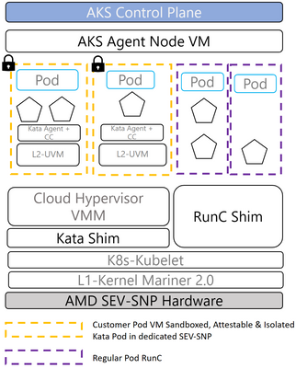
Product design principles
1. Transparency:
All components of the Trusted Computing Base (TCB) are to be open sourced
2. Auditability:
Verify that version of the Kata CoCo environment including Linux Guest OS is current
Microsoft-signed guest OS and container runtime
Secure hash algorithm (SHA) for audibility and control
3. Reproducibility:
OSS first approach with well-documented build instructions
4. Full attestation:
Fetch hardware AMD SEV-SNP local report that reflects Guest OS image and container runtime
5. Code integrity:
Runtime enforcement through customer-defined policies
Immutable policies and container signing
6. Isolation from operator:
Least privilege and highest isolation security designs
7. Ease of use:
Support for unmodified Linux containers
Notes:
Kata confidential containers with Azure Kubernetes Service (AKS) (microsoft.com)

Slide 102



End to end encryption with Confidential Containers
Key Management Service
Producer
Encrypted data
Encrypted data
Consumer
Azure Event Hubs
Confidential Containers on AKS with Dapr Kafka Binding
Notes:
Reference: Microsoft Build 2023
AMD + Azure: Outstanding performance and the latest security features | Microsoft Build 2023 – YouTube

Slide 103
Demo
End to end encryption with Kata Confidential Container
https://youtu.be/sgIBC3yWa-M?t=2164
Notes:
https://youtu.be/sgIBC3yWa-M?t=2164

Slide 104



Confidential Computing use cases
Government
Digital identity
Critical infrastructure
Anti-corruption
Cyber crime prevention
Judicial proceedings and case management
Deployed and disconnected operations
Safeguarding / vulnerable population protection (including child exploitation, human trafficking, etc.)
Financial Services
Anti-money laundering
Digital currencies
Secure Payment Processing including Credit Card and Bank Transactions
Fraud prevention
Credit risk assessment and qualification from combined bank records
Capital Markets e.g.: Securing Quantitative Hedge Funds code and models
Proprietary analytics / algorithms
Healthcare
Disease diagnostic
Insurance fraud prevention
Drug development
Contact tracing
Records and evidence management
Insurance fraud, waste, and abuse prevention

Slide 105
Confidential computing is state-of-the-art, and Azure is ready!

Slide 106

Thank you!

